Slide 1
iFAMS Deconvolution Software for Mass Spectrometry Analysis
James S. Prell
Department of Chemistry and Biochemistry
University of Oregon, Eugene, OR

Slide 2
What Can We Study with iFAMS?
(interactive Fourier-Transform Analysis for Mass Spectrometry)
Native protein complexes:
Stoichiometry and oligomer state profiles, dependence on conditions
Membrane protein complexes:
Lipid or other ligand binding—how many, which molecules?
Antibodies, glycosylated and modified proteins:
Quantitation from intact ion mass spectra

Slide 3
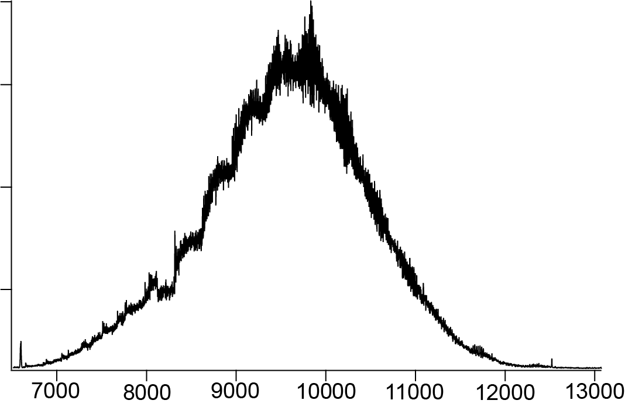
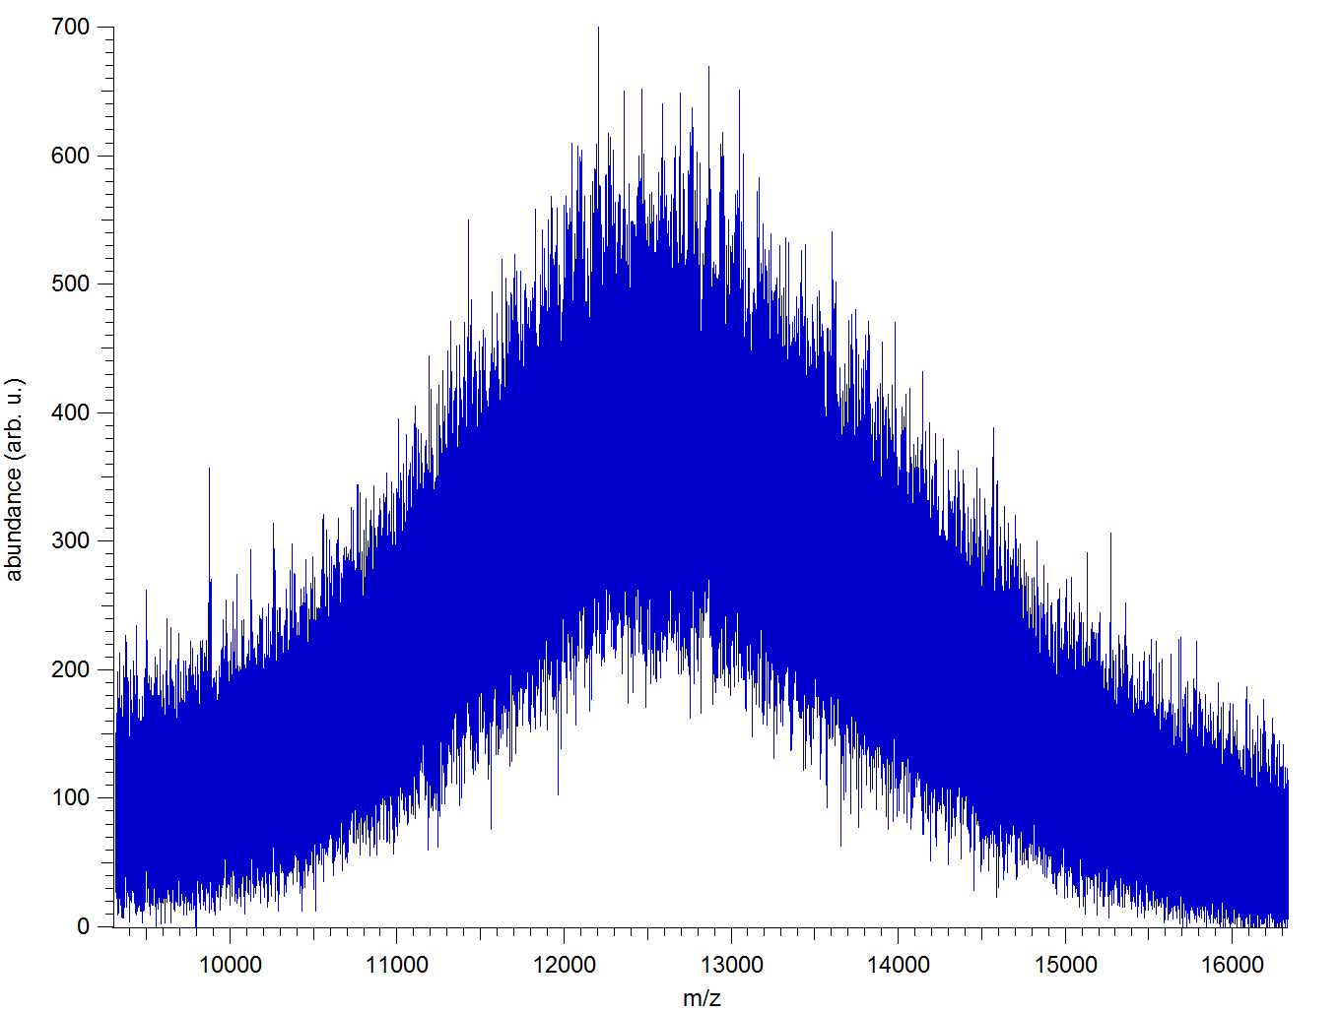
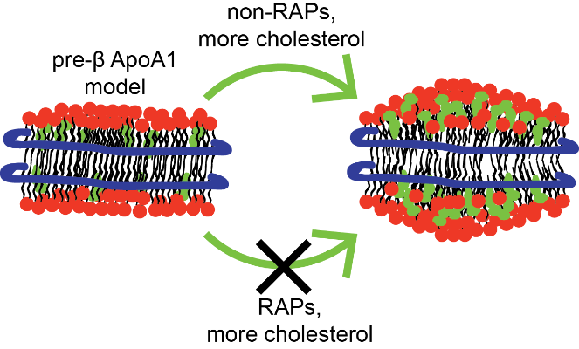
Polydispersity and heterogeneity: the dreaded “blob” spectrum
100
MSP1D1 Nanodisc
with POPC lipids
Staph A.
α-hemolysin
pores in
FOS-14 detergent
micelles
80
60
abundance (arb. u.)
40
20
Synapt G2-Si
Orbitrap EMR
0
10000
12000
14000
16000
m/z
m/z
Polydisperse non-covalent and/or covalent adducts
give rise to “frequencies” in extremely congested mass spectra
that allow us to analyze them much more easily in the frequency domain.

Slide 4
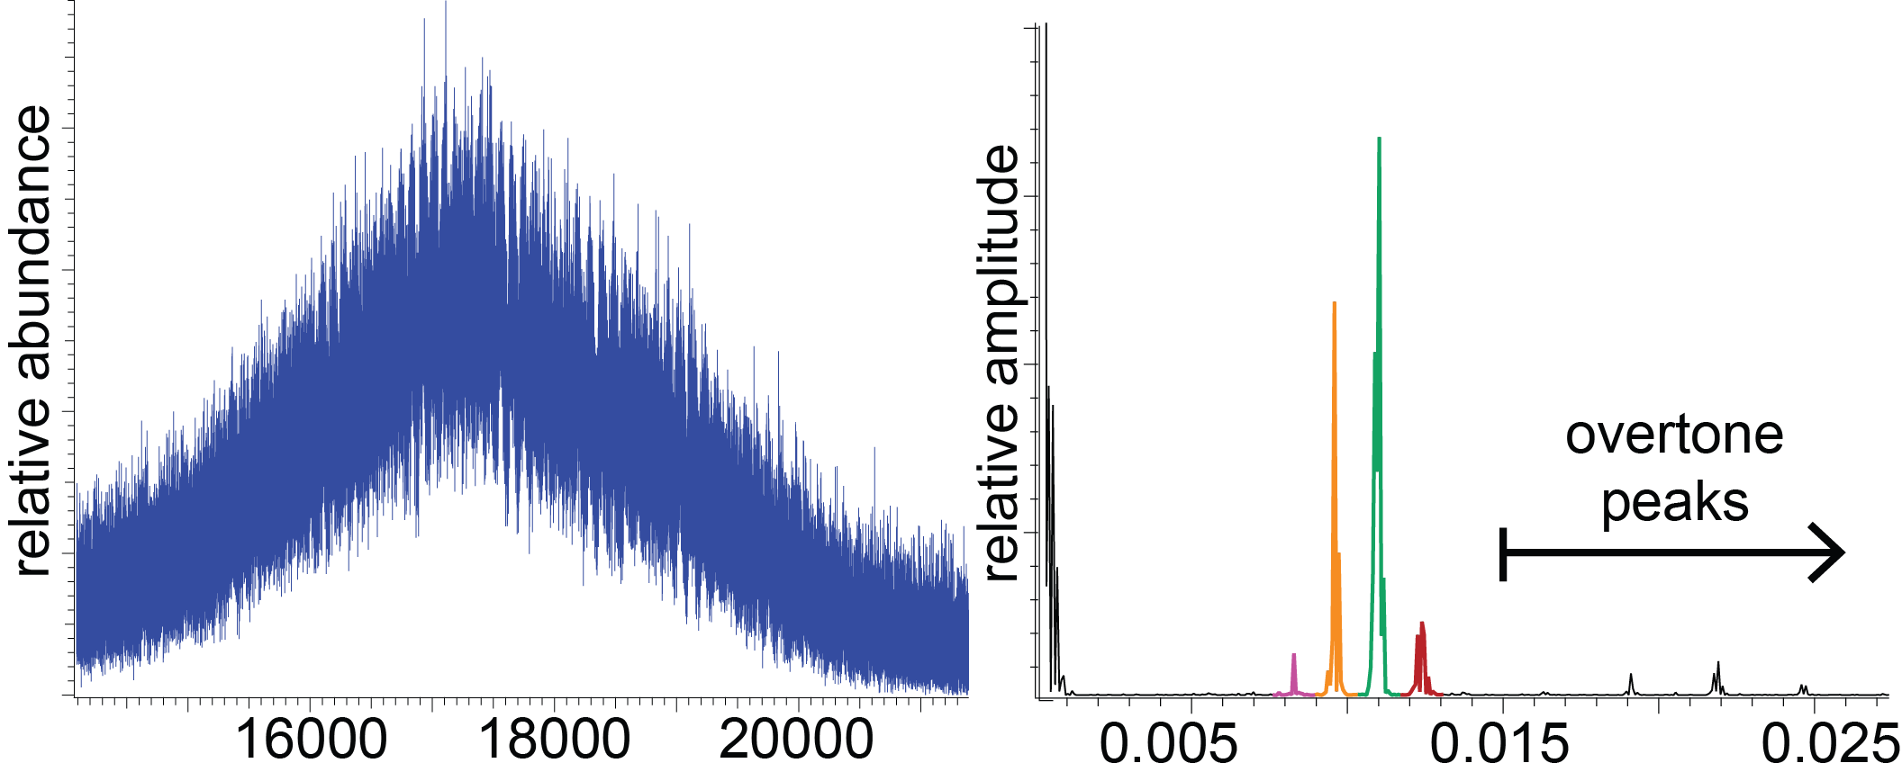
Fourier Transform analysis for polydisperse Nanodiscs
mass spectrum
Fourier spectrum
Synapt G2-Si
m/z
“frequency”, z/(Δm)
Fourier duality:
“ugly” mass spectra often yield clean Fourier spectra

Slide 5
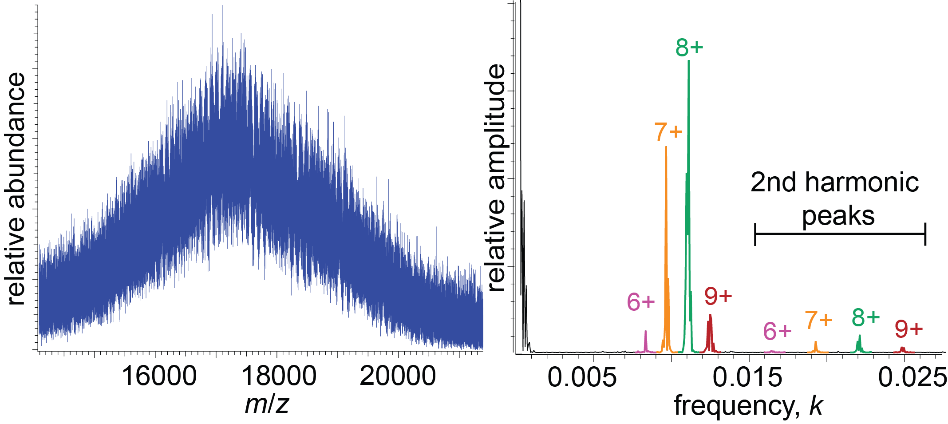
Fourier Transform analysis for polydisperse Nanodiscs
mass spectrum
Fourier spectrum
measured lipid mass: 734.1 ± 0.2 u
(DPPC mol. wt. 734.0 u)
m/z
“frequency”, z/(Δm)
Fourier peak spacing = 1/lipid mass,
now charge states can be easily (automatically!) assigned

Slide 6
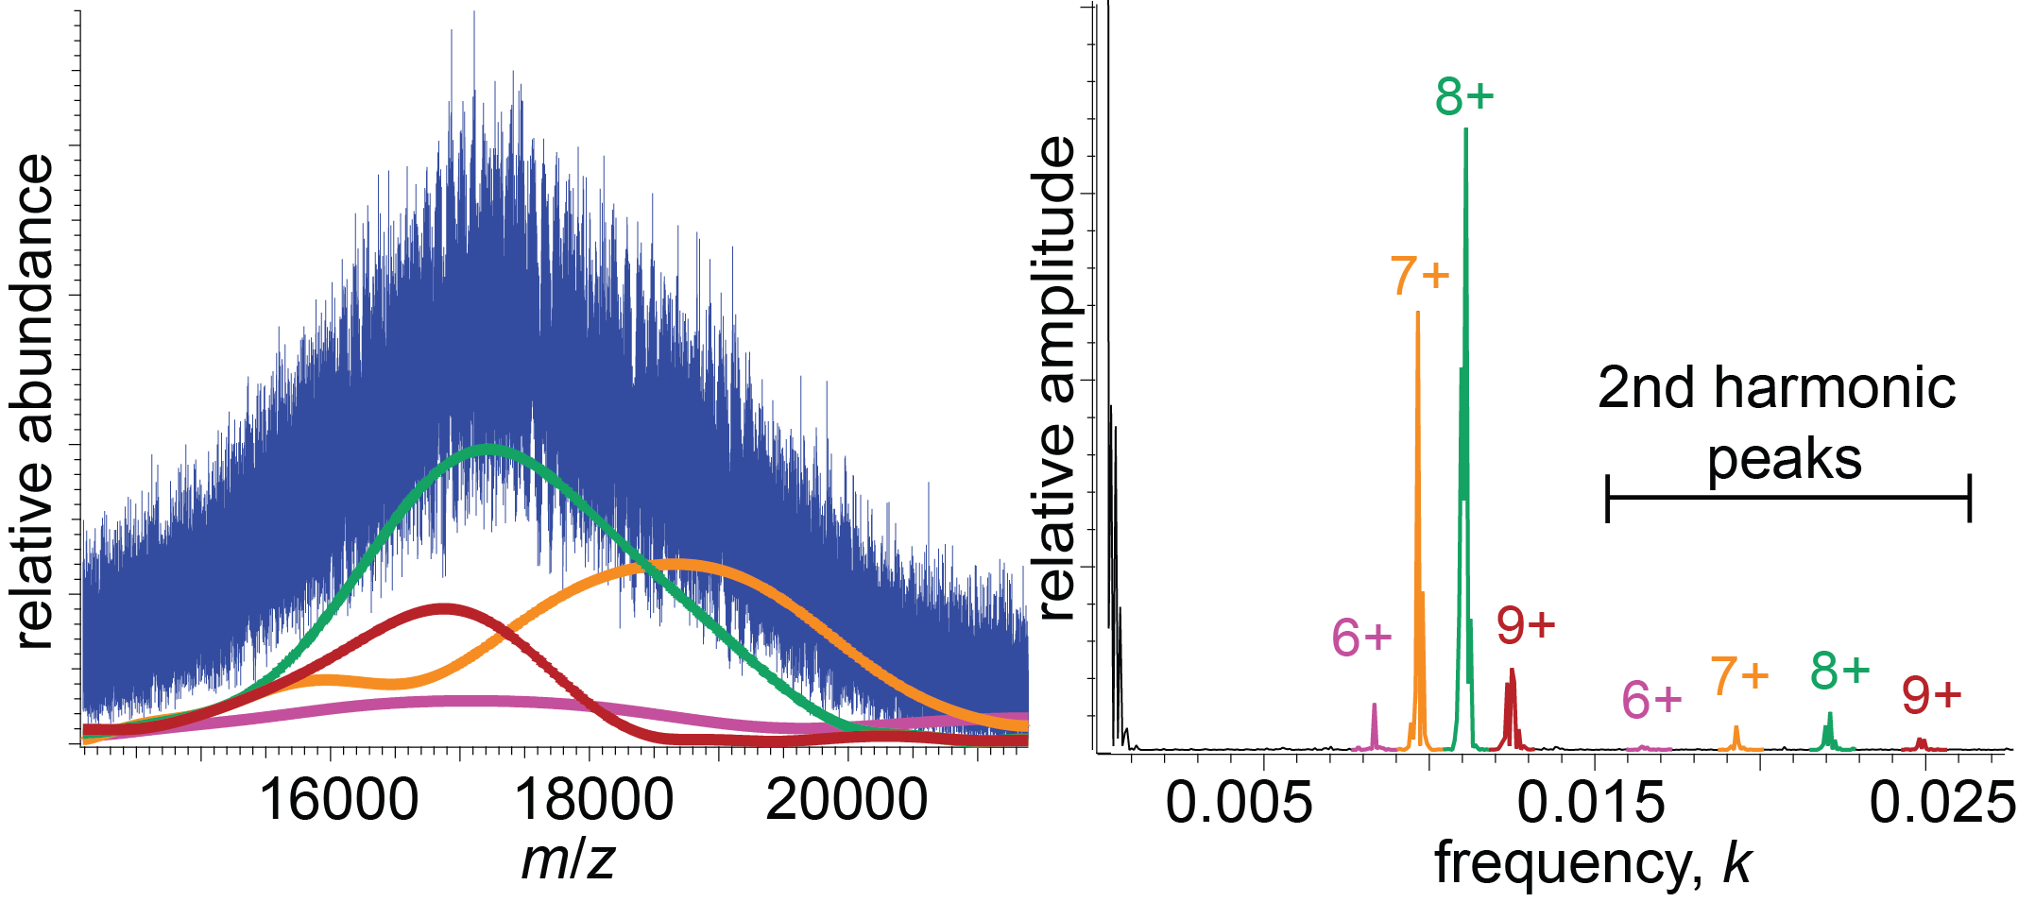
Fourier Transform analysis for polydisperse Nanodiscs
mass spectrum
IFT
Fourier spectrum
m/z
“frequency”, z/(Δm)
inverse Fourier transform of Fourier peaks
yields charge-state-specific mass spectral envelopes
(stoichiometry profile)

Slide 7
Quiz Time!
Suppose iFAMS identifies fundamental peaks for you at frequencies
0.02802, 0.02950, 0.03097, and 0.03245 (= z/subunit mass)
What is the subunit mass?
~678 Da
What are the charge states?
19, 20, 21, 22+
At what frequency would you find the 3rd harmonic
peak for the 20+ charge state?
0.08850

Slide 8
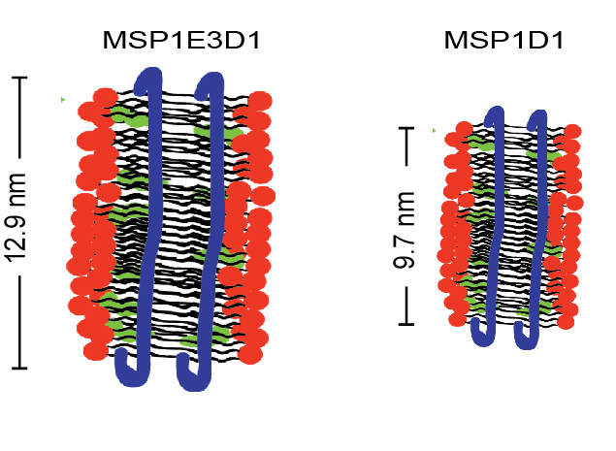
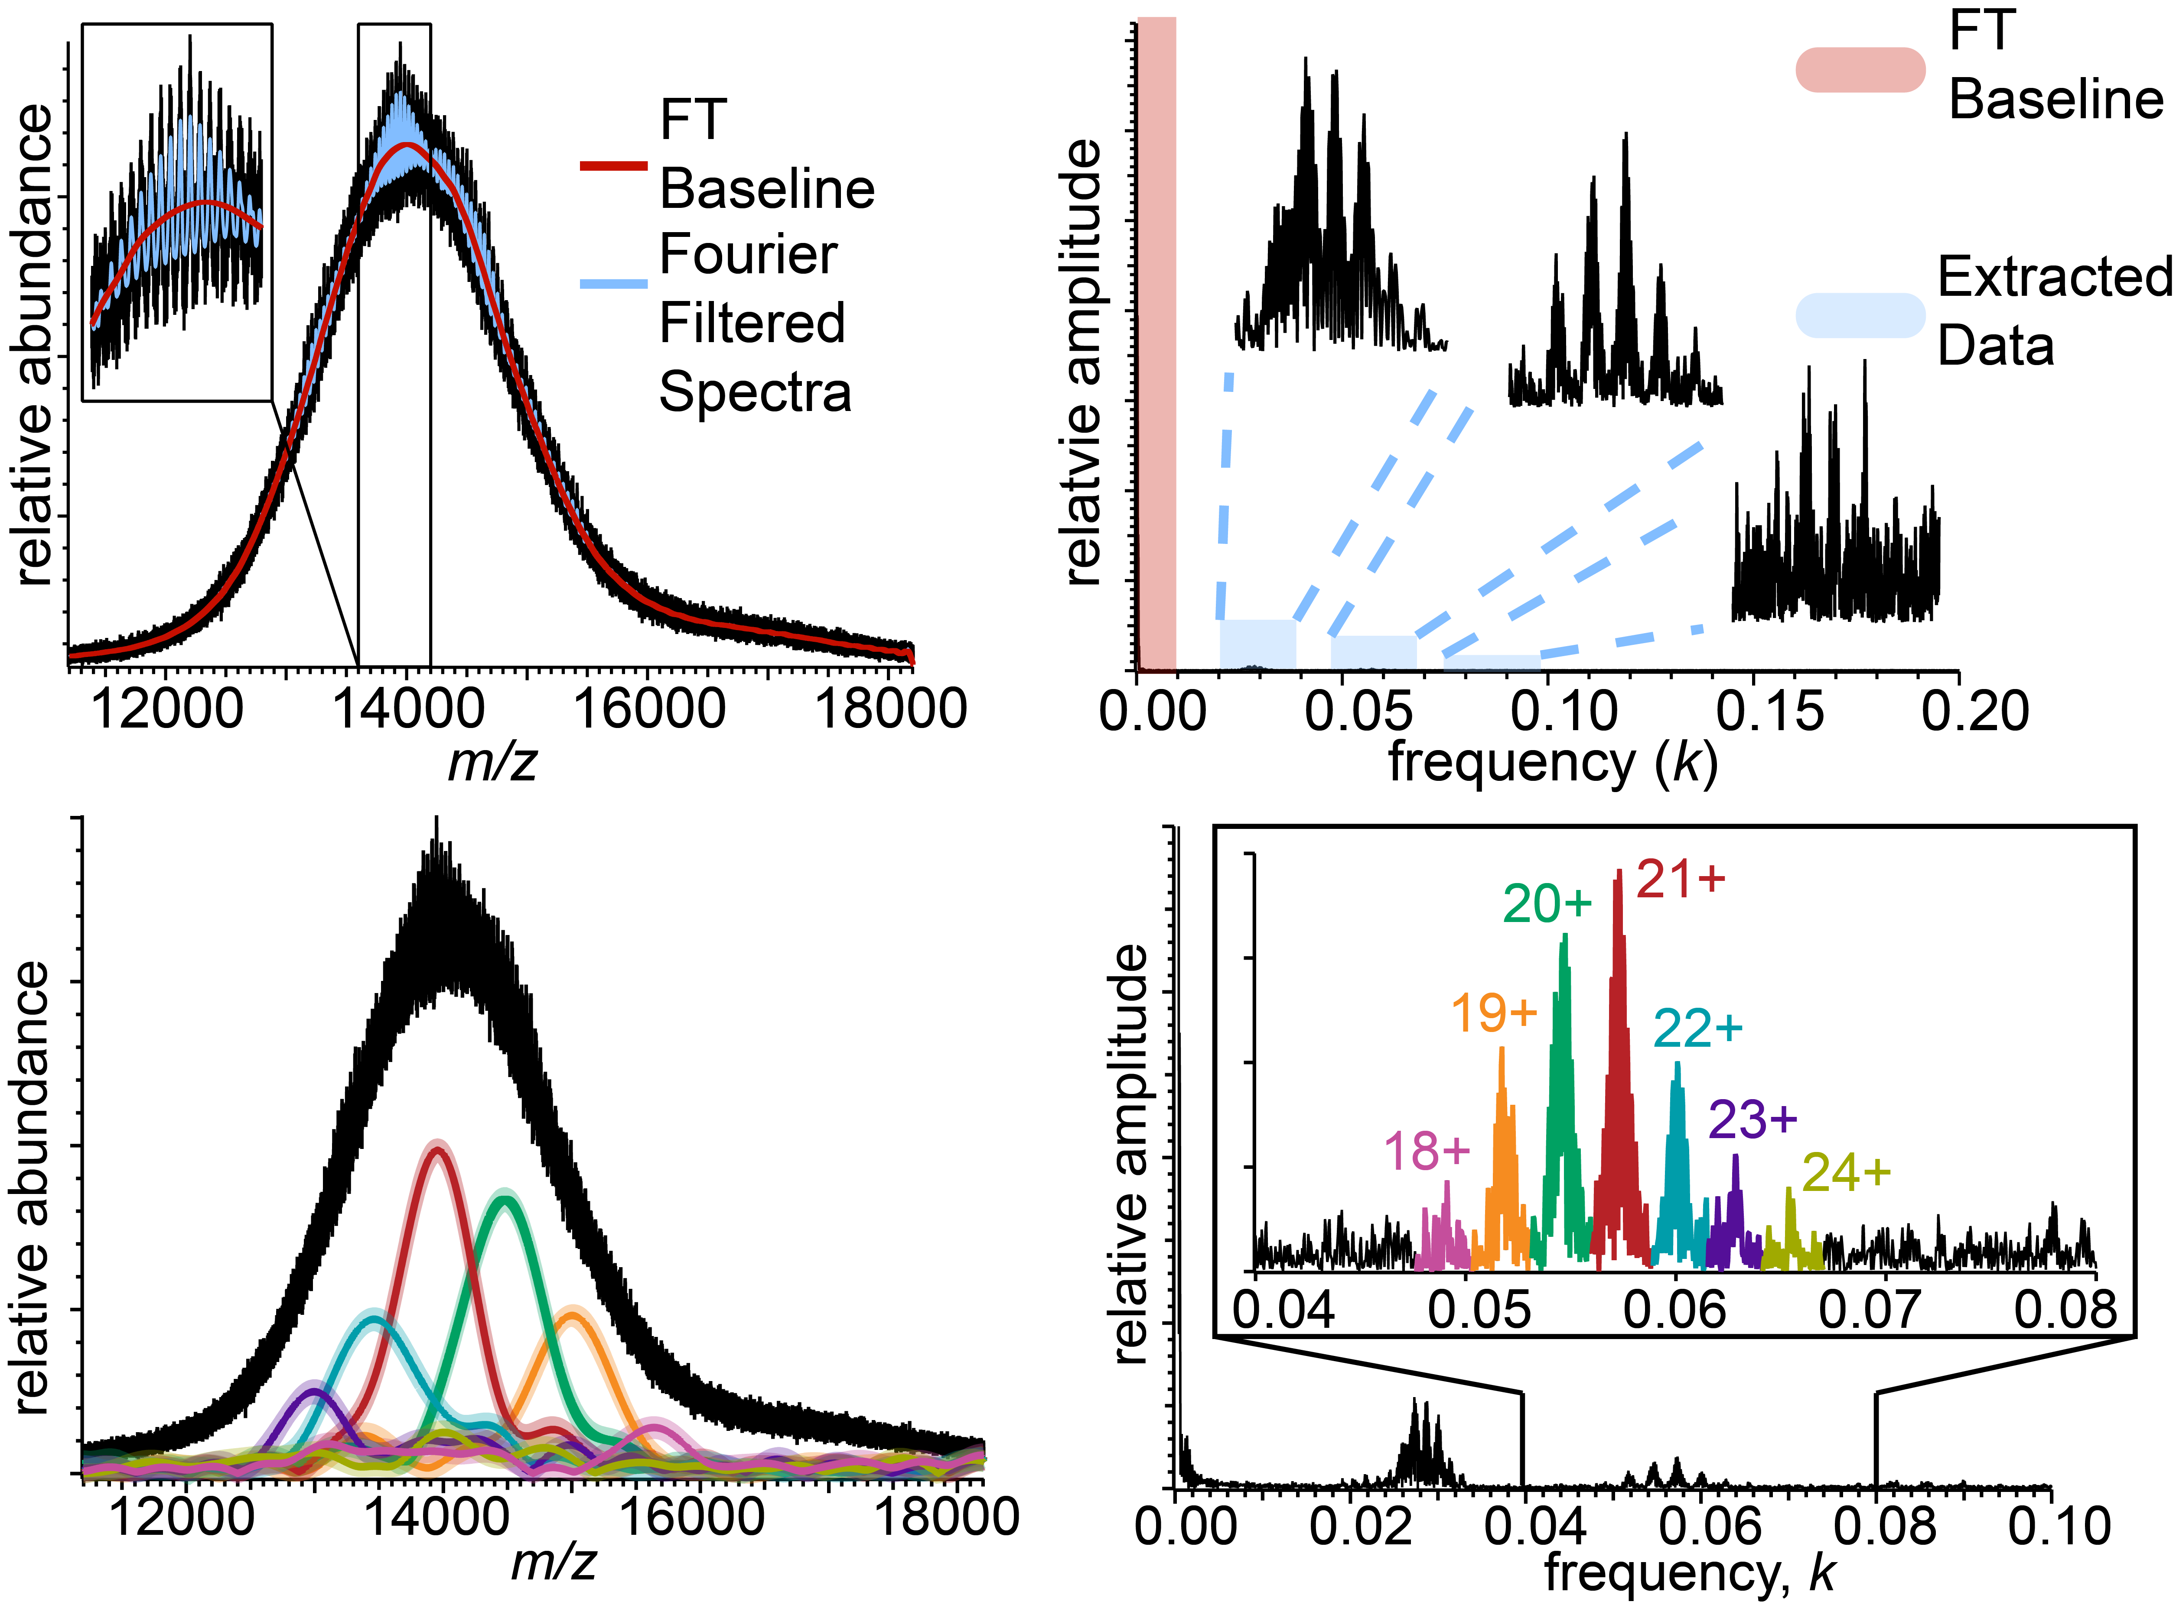
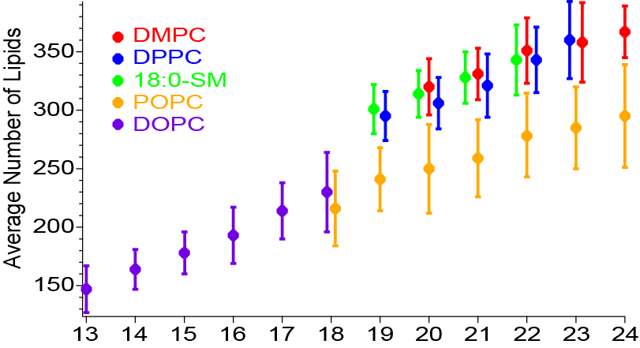
Stoichiometry characterization of “large” Nanodiscs
Cleary, Prell and co., J. Am. Soc. Mass Spectrom. 2018, 29, 2067
lipid stoichiometry ↓
as lipid footprint ↑
charge state

Slide 9
PEGylated Protein Analysis
Sample: PEGylated Granulocyte Colony Stimulating Factor
(PEG-GCSF)
input identical
raw nESI
mass spectra
1+ MALDI-TOF
data
Campuzano et al. Anal. Chem. 2019, 91, 9472-9480

Slide 10
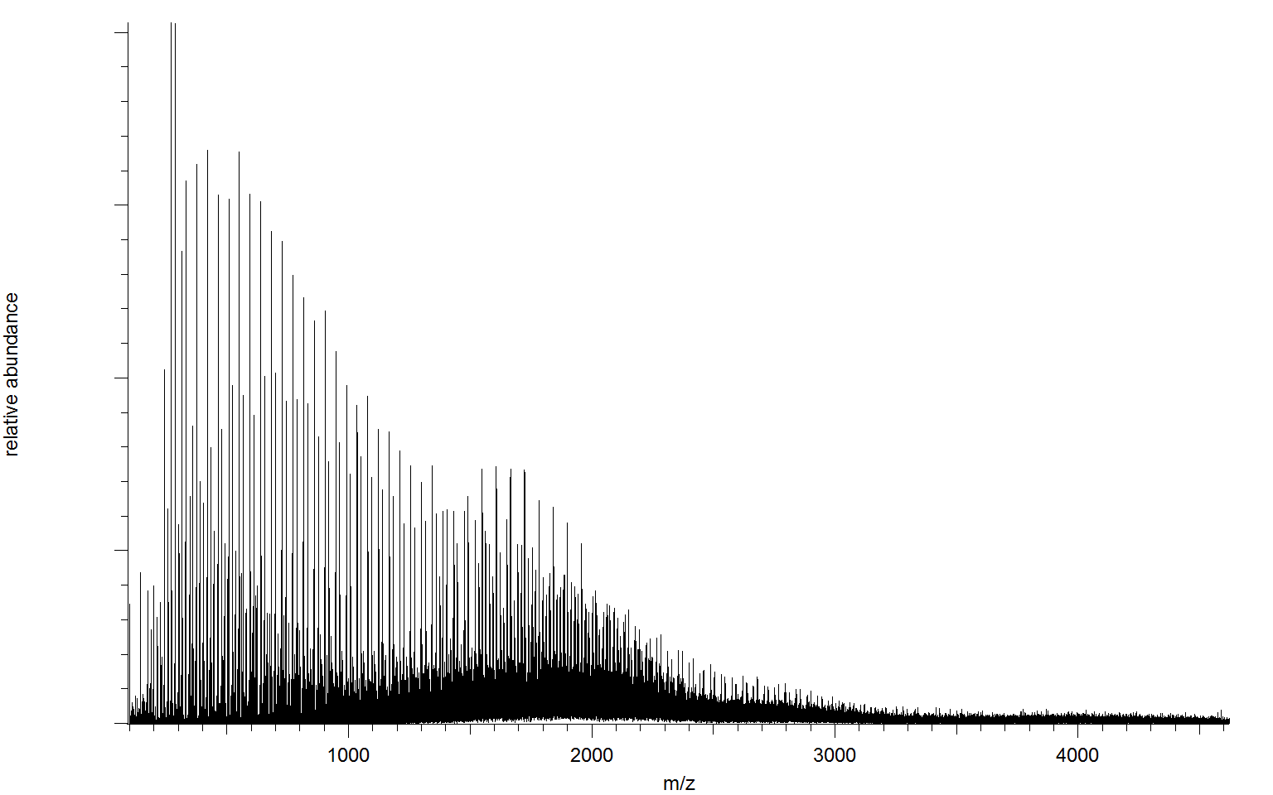
Gábor Transform: localized frequencies
ESI spectrum of
PEG:PPG:PEG
block copolymer
relative abundance
Cleary and Prell
ChemPhysChem 2019
1000
2000
3000
4000
m/z
1. multiply mass spectrum by Gaussian (or other shape) window
2. find FT frequencies within windowed spectrum
3. slide window to the right
4. repeat, and plot FT spectra vs. window center (2D “spectrogram”)

Slide 11
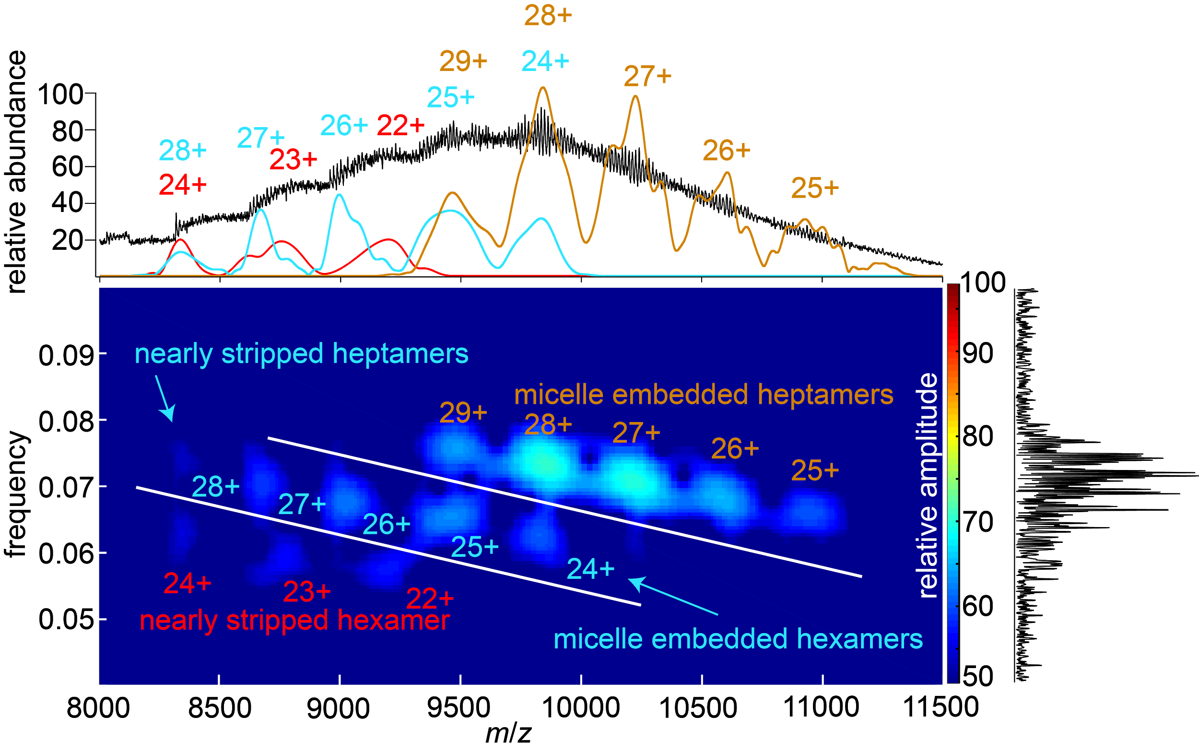
Chirp patterns make it easy to find complexes of different composition
membrane pore toxin α-hemolysin
in detergent micelles
GT spectrum practically
analyzes itself!
Ions overlapped in both
m/z and frequency
are resolved!
Wilson, Prell and co. Anal. Chem. 2019
Notes:
So we can then analyze these three overlapping distributions and we find our highest frequency distribution corresponds to the detergent micelle embedded heptamers, the middle distribution is actually two distributions with nearly stripped heptameric complexes and micelle embedded hexamers that overlap significantly in m/z and charge state, and our lowest frequency distribution corresponding to the nearly detergent stripped hexameric pore complexes

Slide 12
Quiz Time!
For a biomolecular ion, why should frequency
decrease left-to-right in mass spectrum?
High charges are on the left for a native ion,
so frequency = z/(subunit mass) will be
higher on the left, at lower m/z.

Slide 13
iFAMS Can Also Distinguish Types of Compositional Heterogeneity
“simple” mixture:
superposition of “pure” populations
“random” mixture:
convolution of subunit populations
Cleary and Prell Analyst 2020 DOI:10.1039/D0AN00726A

Slide 14
Mixed-Lipid Nanodisc Composition
See
Cleary and Prell Analyst
2020 DOI:10.1039/D0AN00726A
for mathematical proof of method
and Hoi, Robinson, Marty Anal Chem
2016 DOI: 10.1021/acs.analchem.6b00851
for a nice illustration of same concept

Slide 15
Block Copolymer Composition
PEG
PPG
PEG
Sigma (manufacturer):
average mass 8400 Da
3.8:1 PEG:PPG units
(¹H-NMR headgroup analysis)
iFAMS:
average mass 8370 ± 970 Da
PEG mass 6810 ± 880 Da
PPG mass 1560 ± 420 Da
4.37:1 PEG:PPG
Richer information from iFAMS nESI data
Eliminate contributions from low-mass polymer interferents

Slide 16
iFAMS Tutorial Demonstration
Download at:
github.com/prellgroup/iFAMS/releases
You’ll want to download and unzip
iFAMS_V5.4_GUI.zip

Slide 17
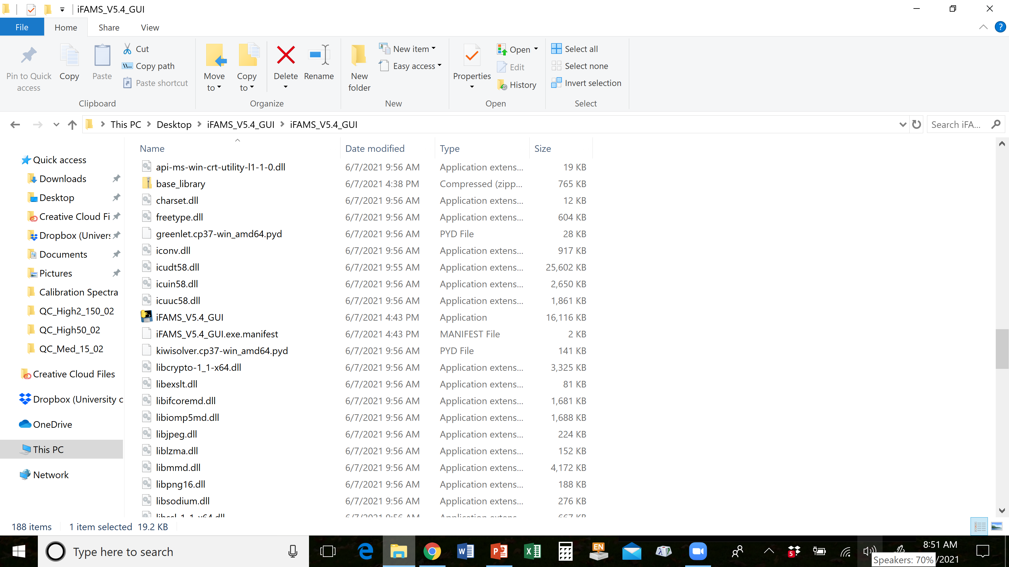
iFAMS_V5.4_GUI
is the interactive
version of iFAMS

Slide 18
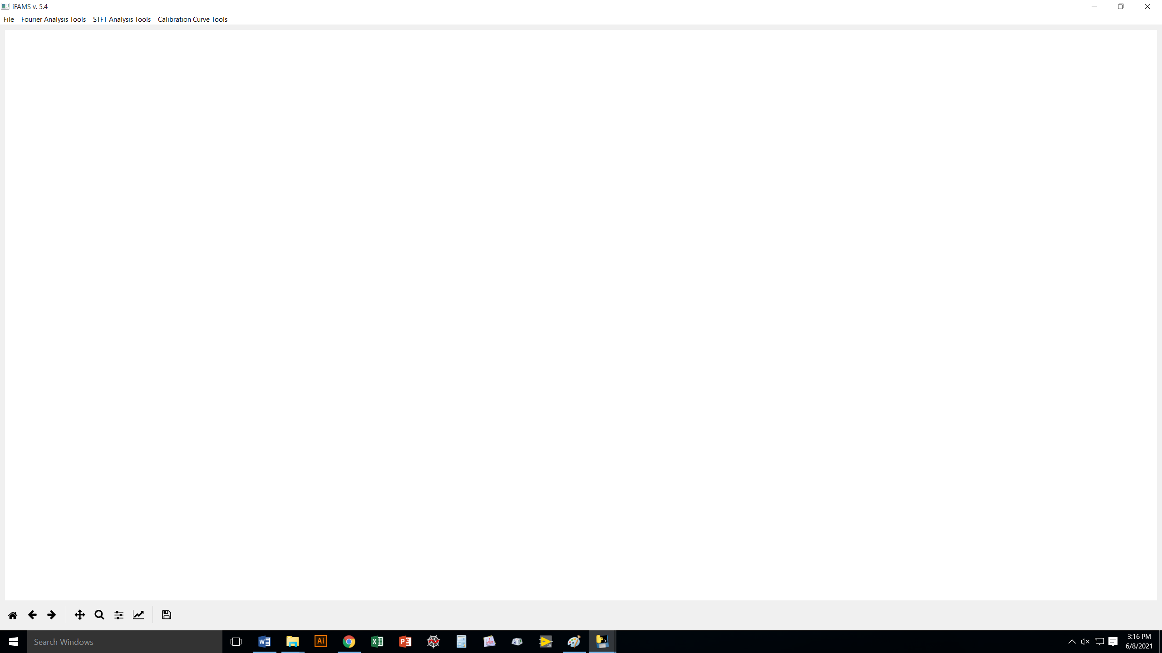
We’re going to load up a file called “test.csv” to illustrate a lot of the iFAMS features.
Note that iFAMS will take .csv or .txt files (first column is m/z, second column is abundance)
as input files.
(You can easily export these from just about any commercial MS software.)

Slide 19
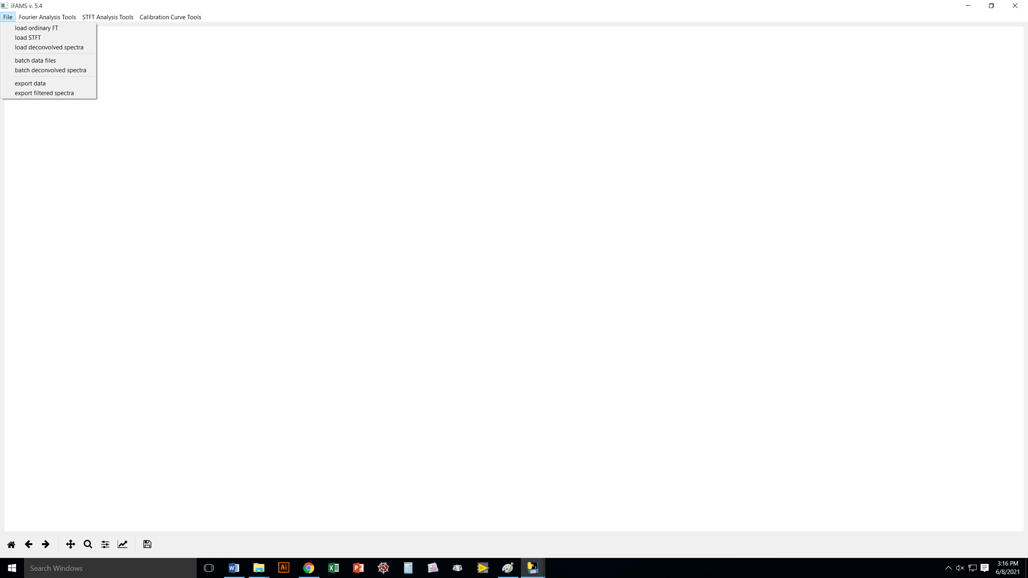
We’re going to load up a file called “test.csv” to illustrate a lot of the iFAMS features.
Note that iFAMS will take .csv or .txt files (first column is m/z, second column is abundance)
as input files.
(You can easily export these from just about any commercial MS software.)

Slide 20
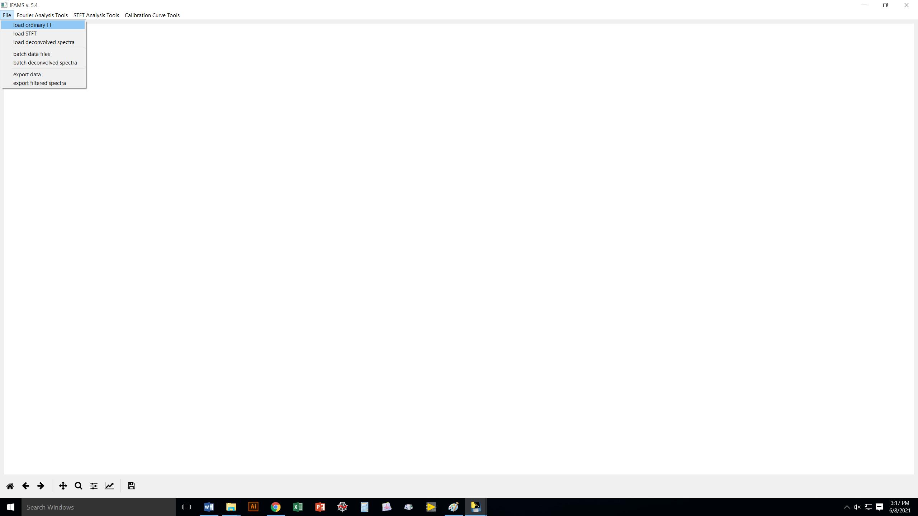
We’re going to load up a file called “test.csv” to illustrate a lot of the iFAMS features.
Note that iFAMS will take .csv or .txt files (first column is m/z, second column is abundance)
as input files.
(You can easily export these from just about any commercial MS software.)

Slide 21
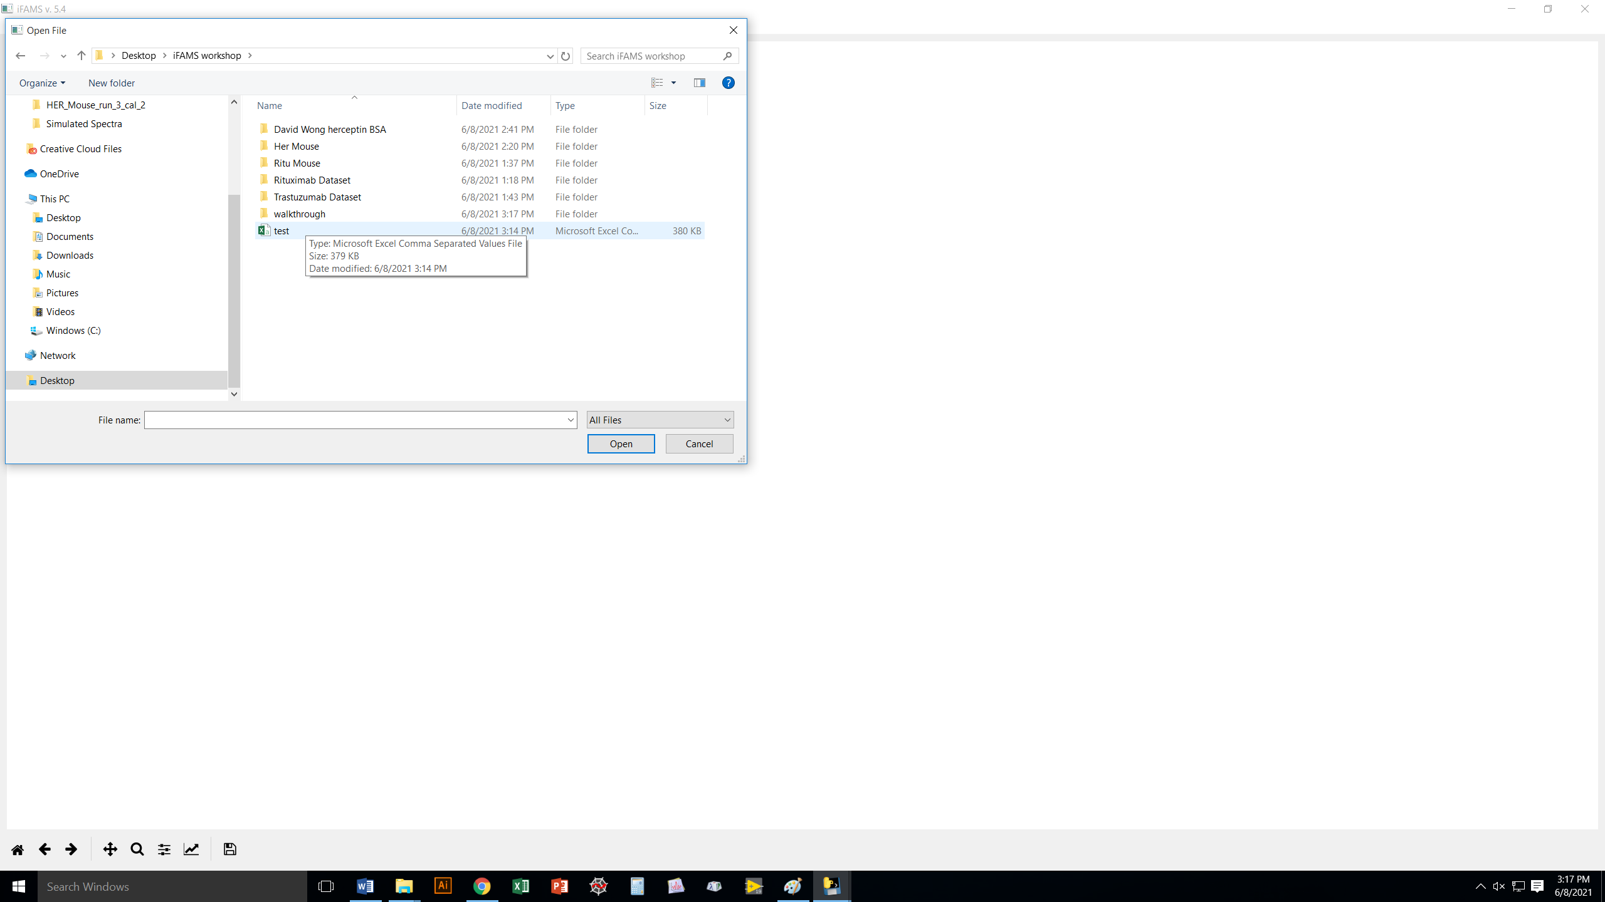

Slide 22
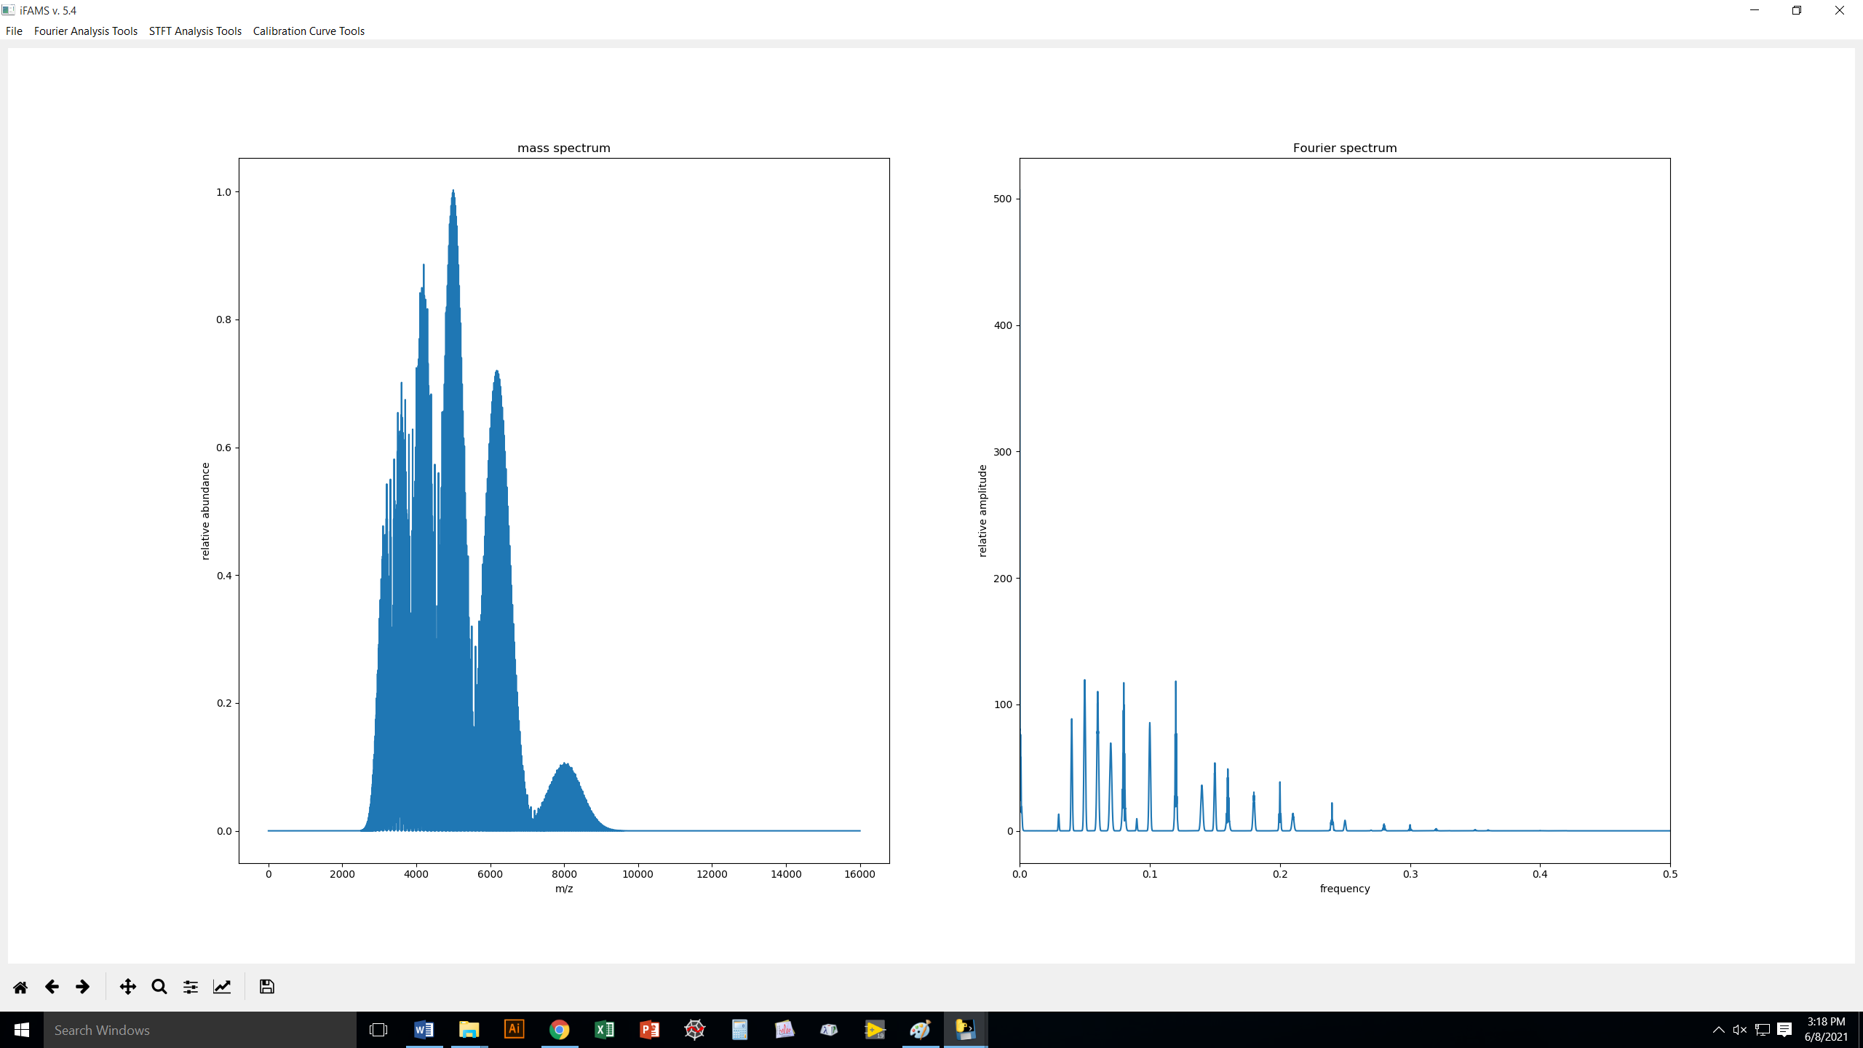
The test.csv mass
spectrum is polydisperse
with multiple overlapped
charge states.
Already you can see that the Fourier
spectrum is a lot simpler.

Slide 23
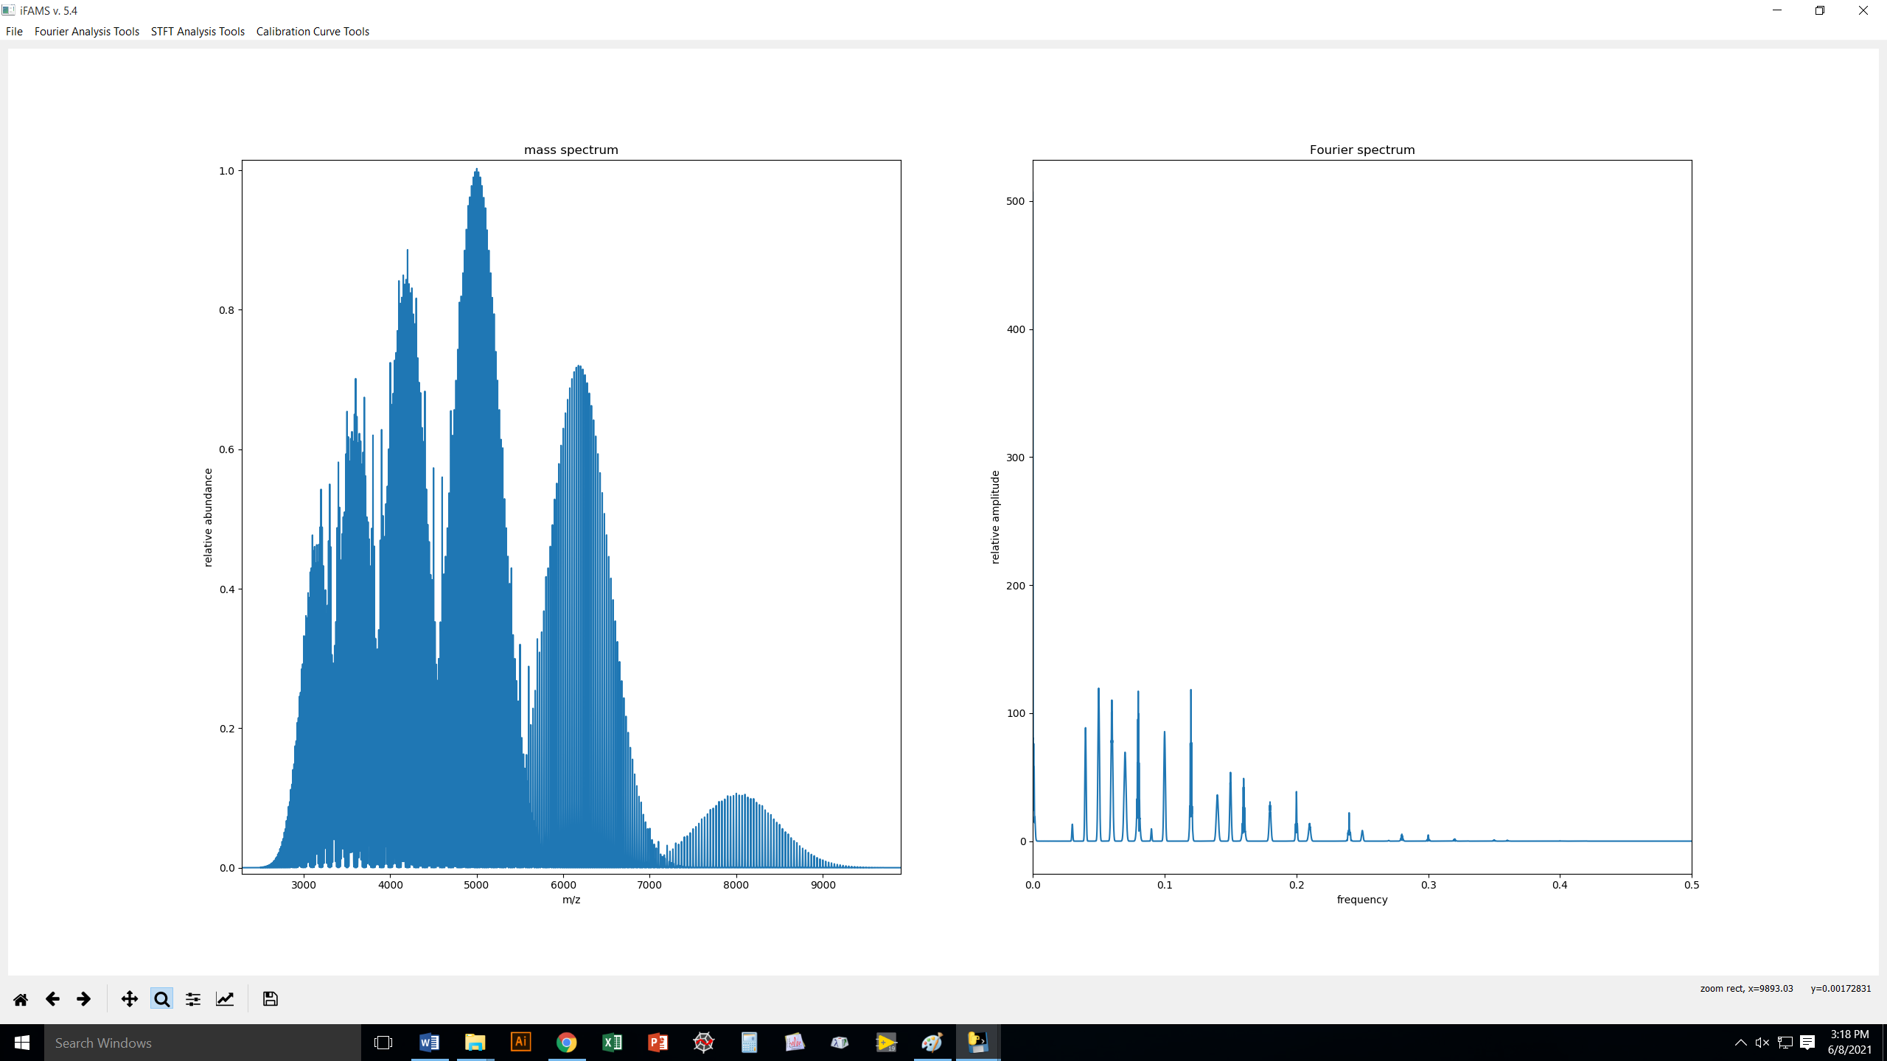
fundamentals
harmonics
Zoom tool

Slide 24
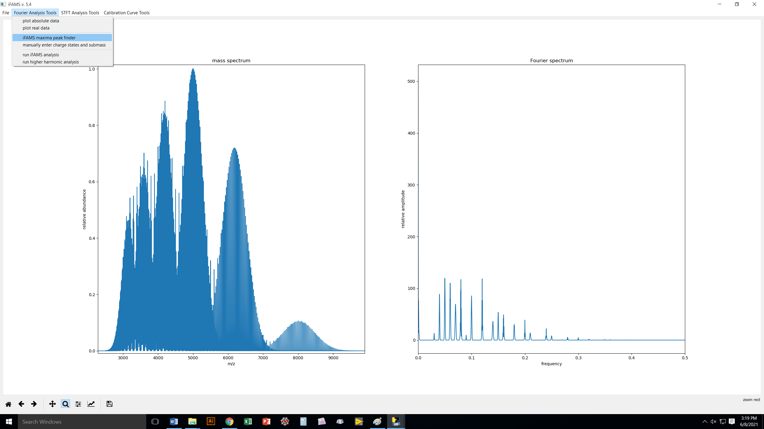

Slide 25
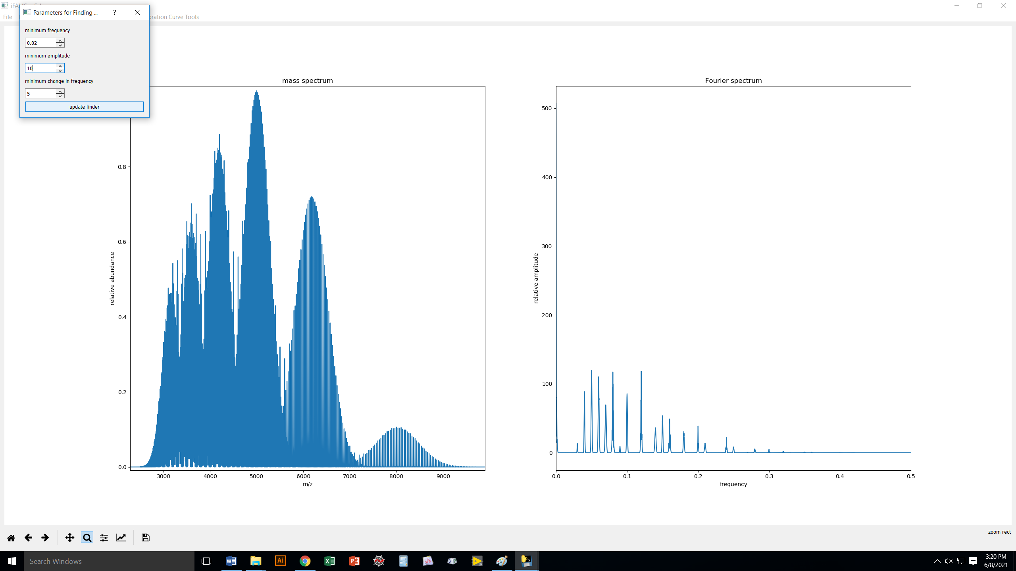
Here, we are telling iFAMS where
we want it to look for peaks in the FT
spectrum.

Slide 26
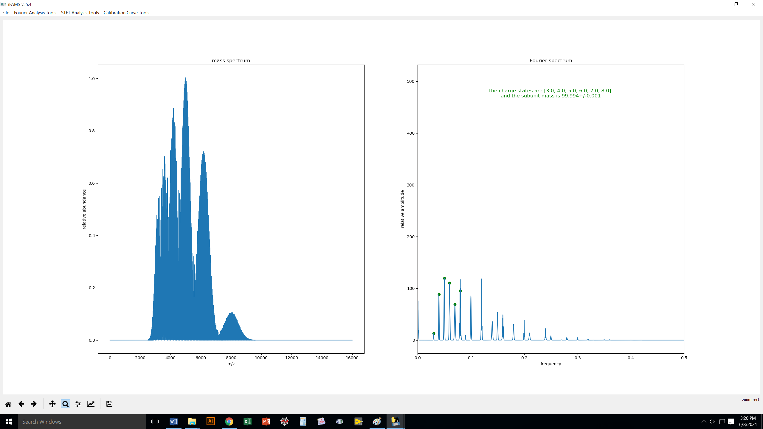
iFAMS found the charge states
for the fundamentals and the
subunit mass.
Note: 8/6 are multiples of 4/3,
so we expect some harmonic
interferences with FT analysis

Slide 27
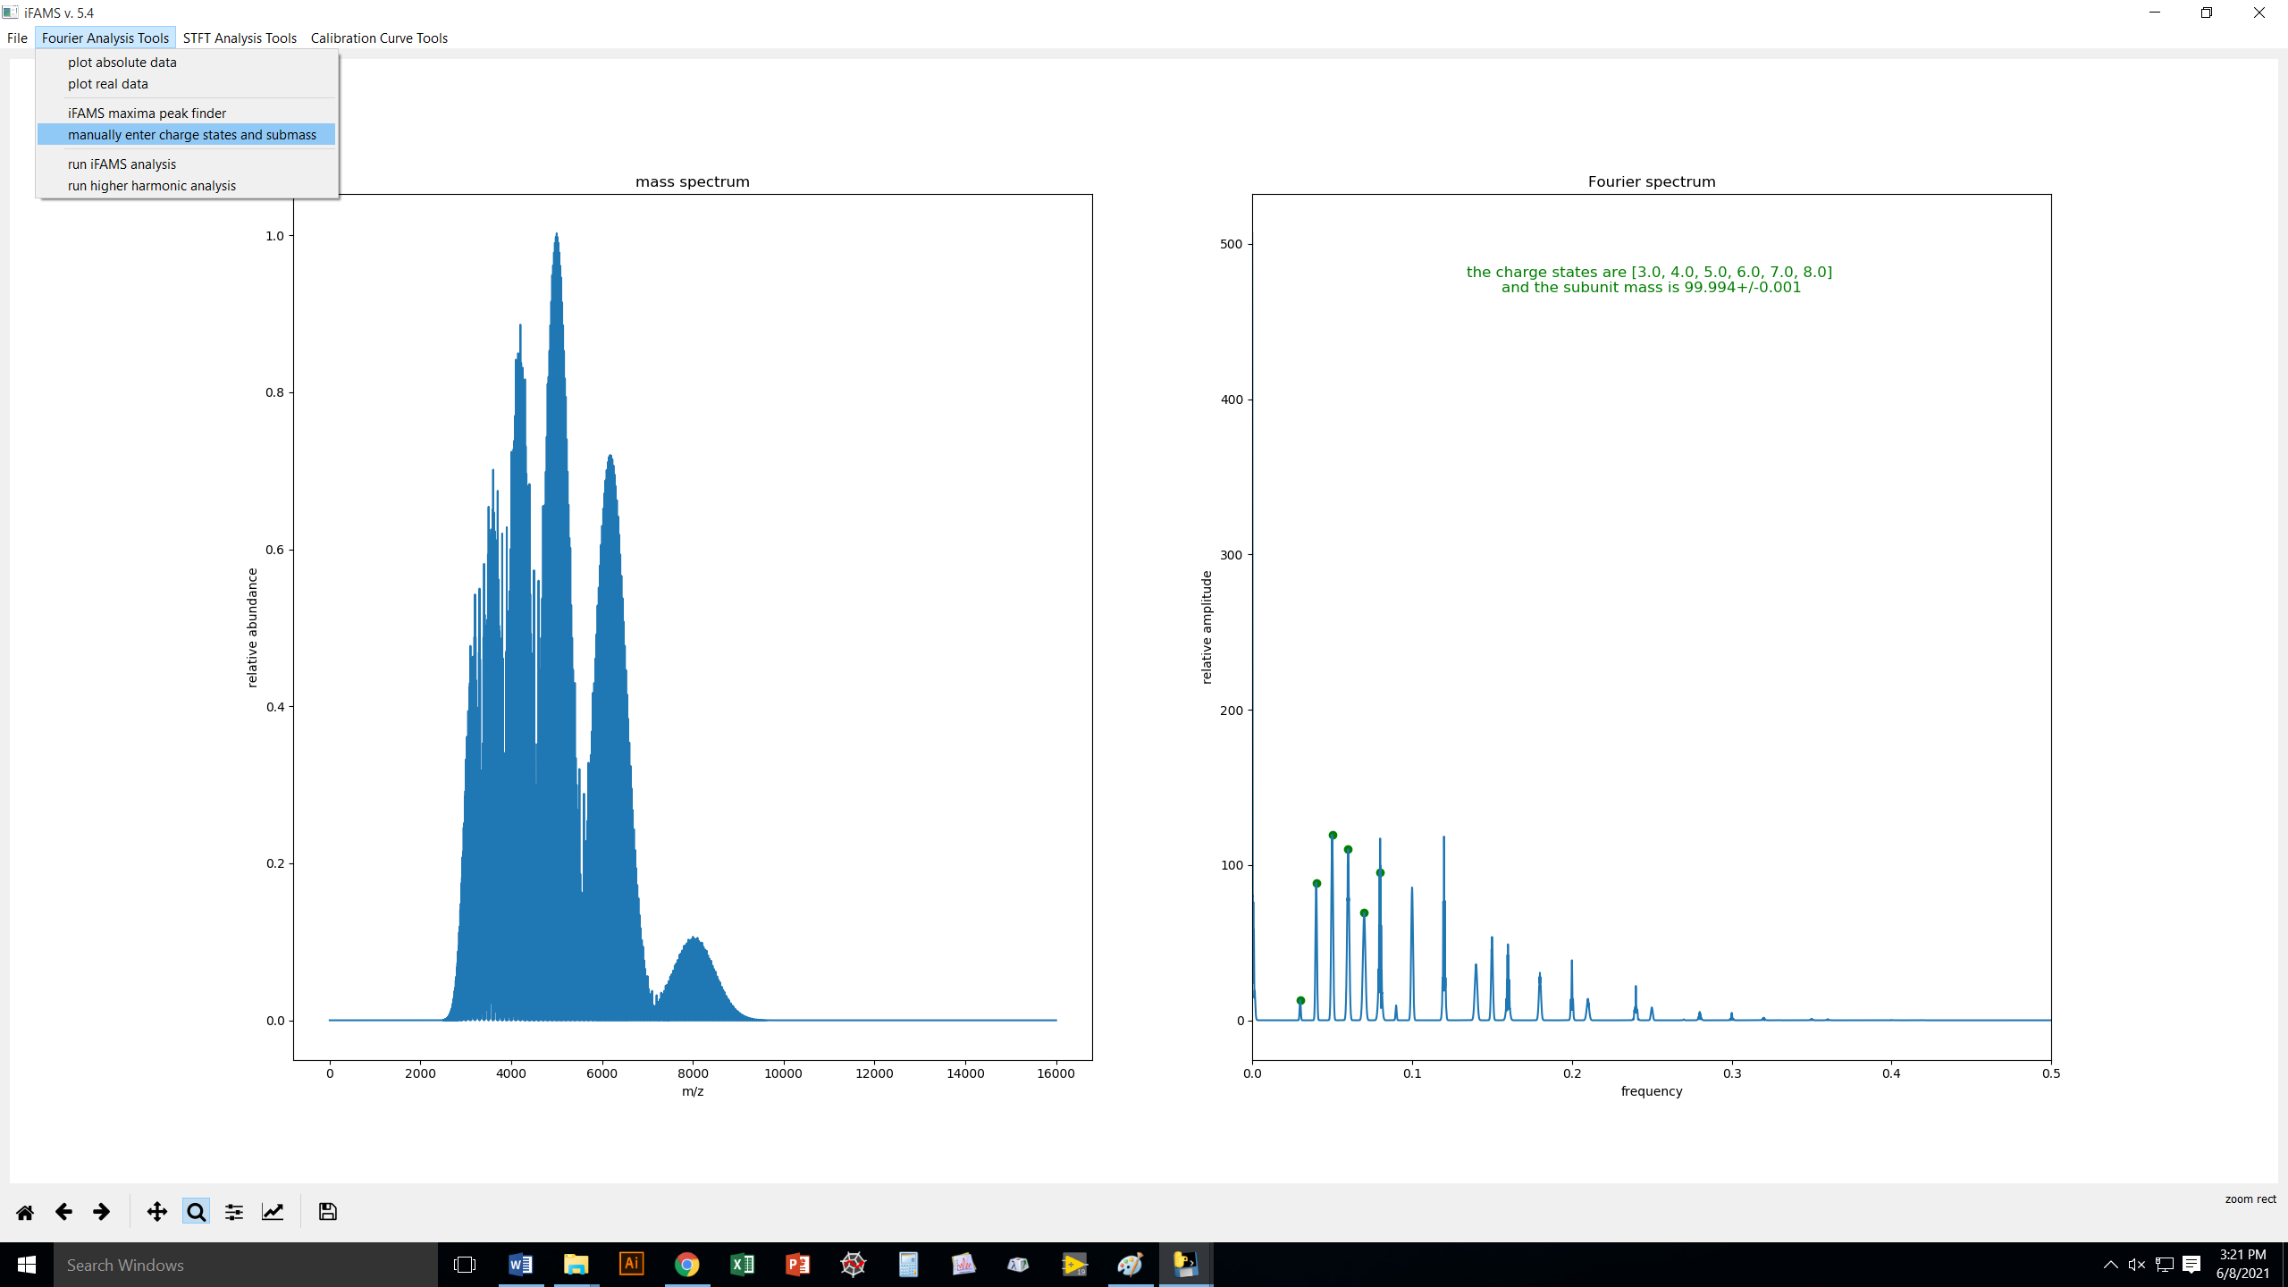
There may be times when you want to tell iFAMS directly what you know the charge states and
subunit mass to be. Just depends on your needs!

Slide 28

This is the DECONVOLUTION step.

Slide 30
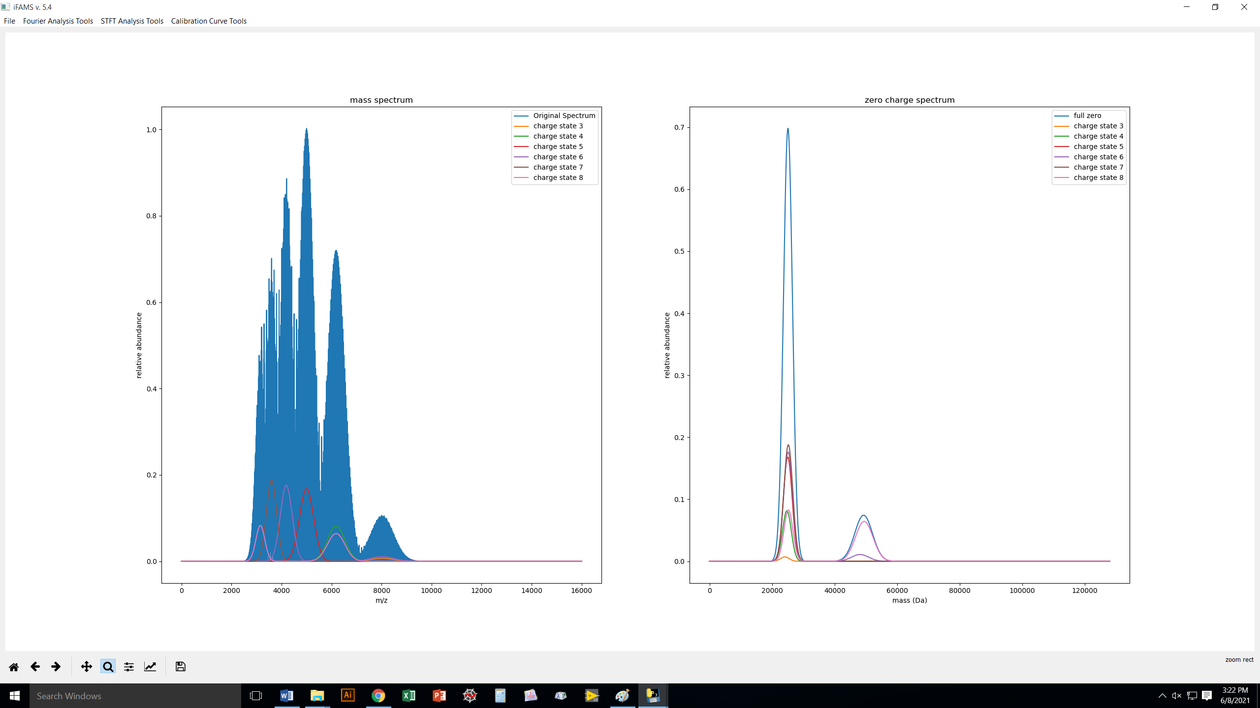
data from fundamentals alone
harmonic artifacts

Slide 31
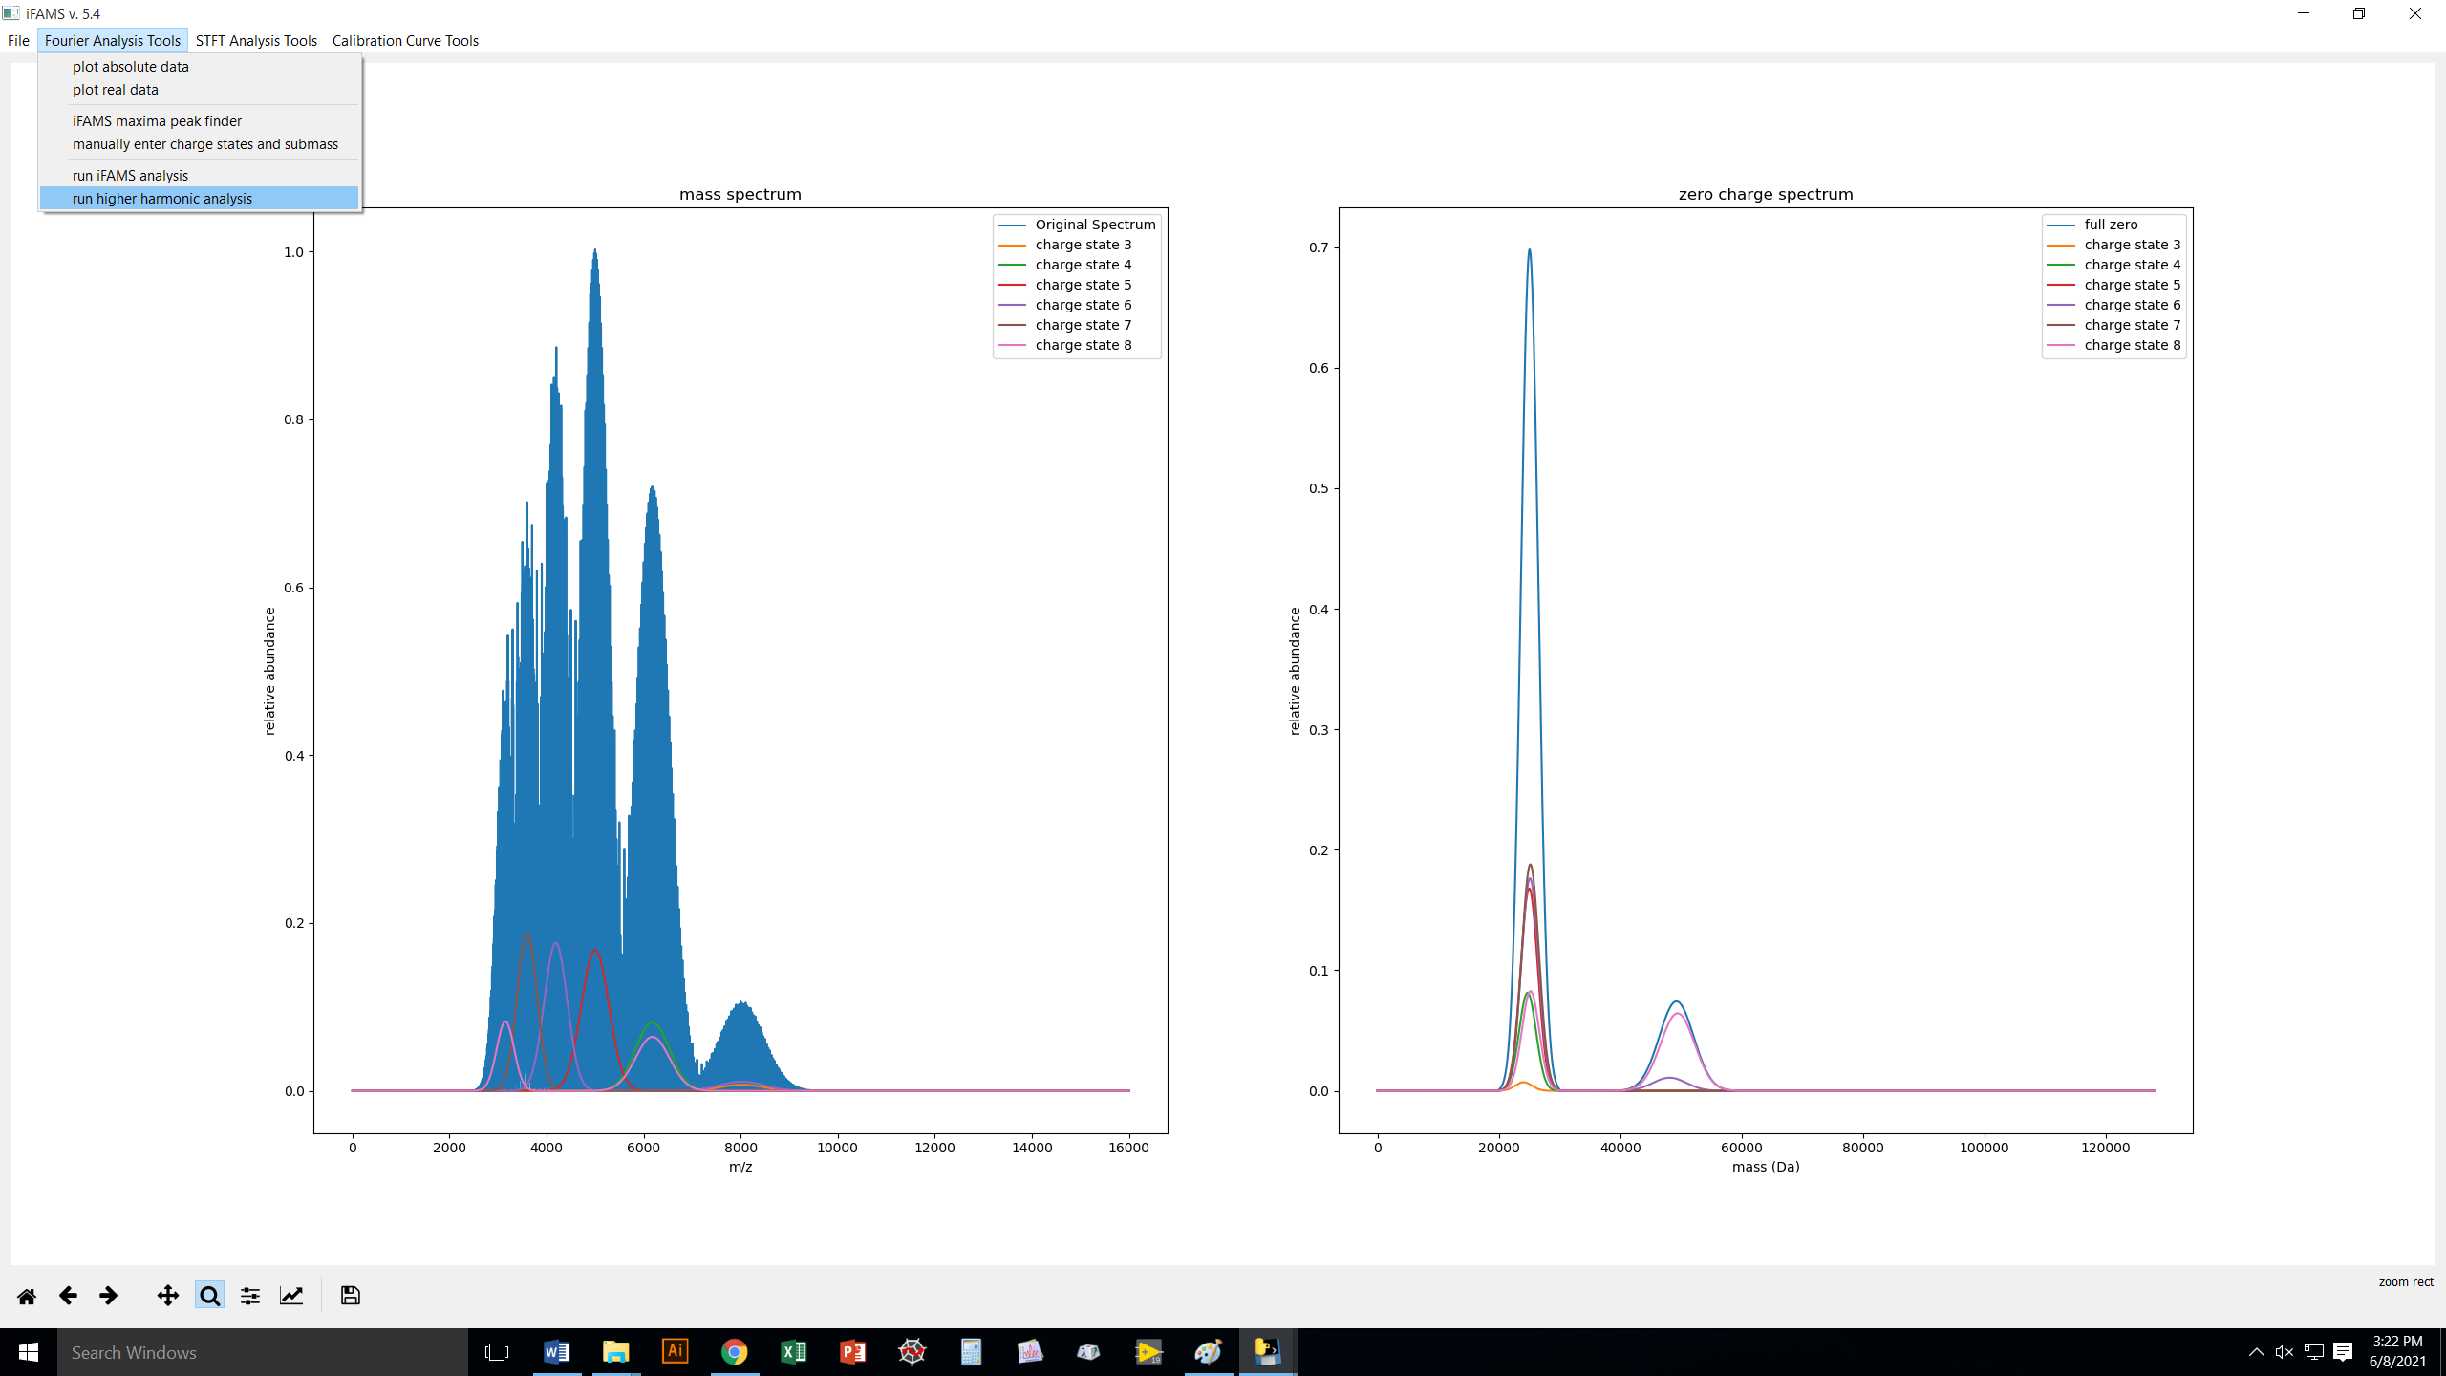
Including more harmonics will improve the resolution of the deconvoluted data.

Slide 32
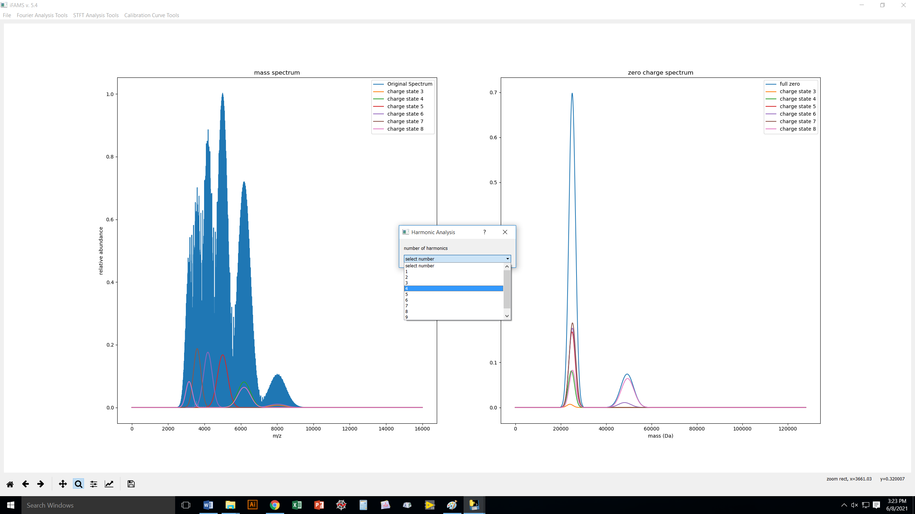
Here, we are going to include 4 harmonics.
Generally, include as many as are resolved
in your FT spectrum without extreme
harmonic overlap.

Slide 33
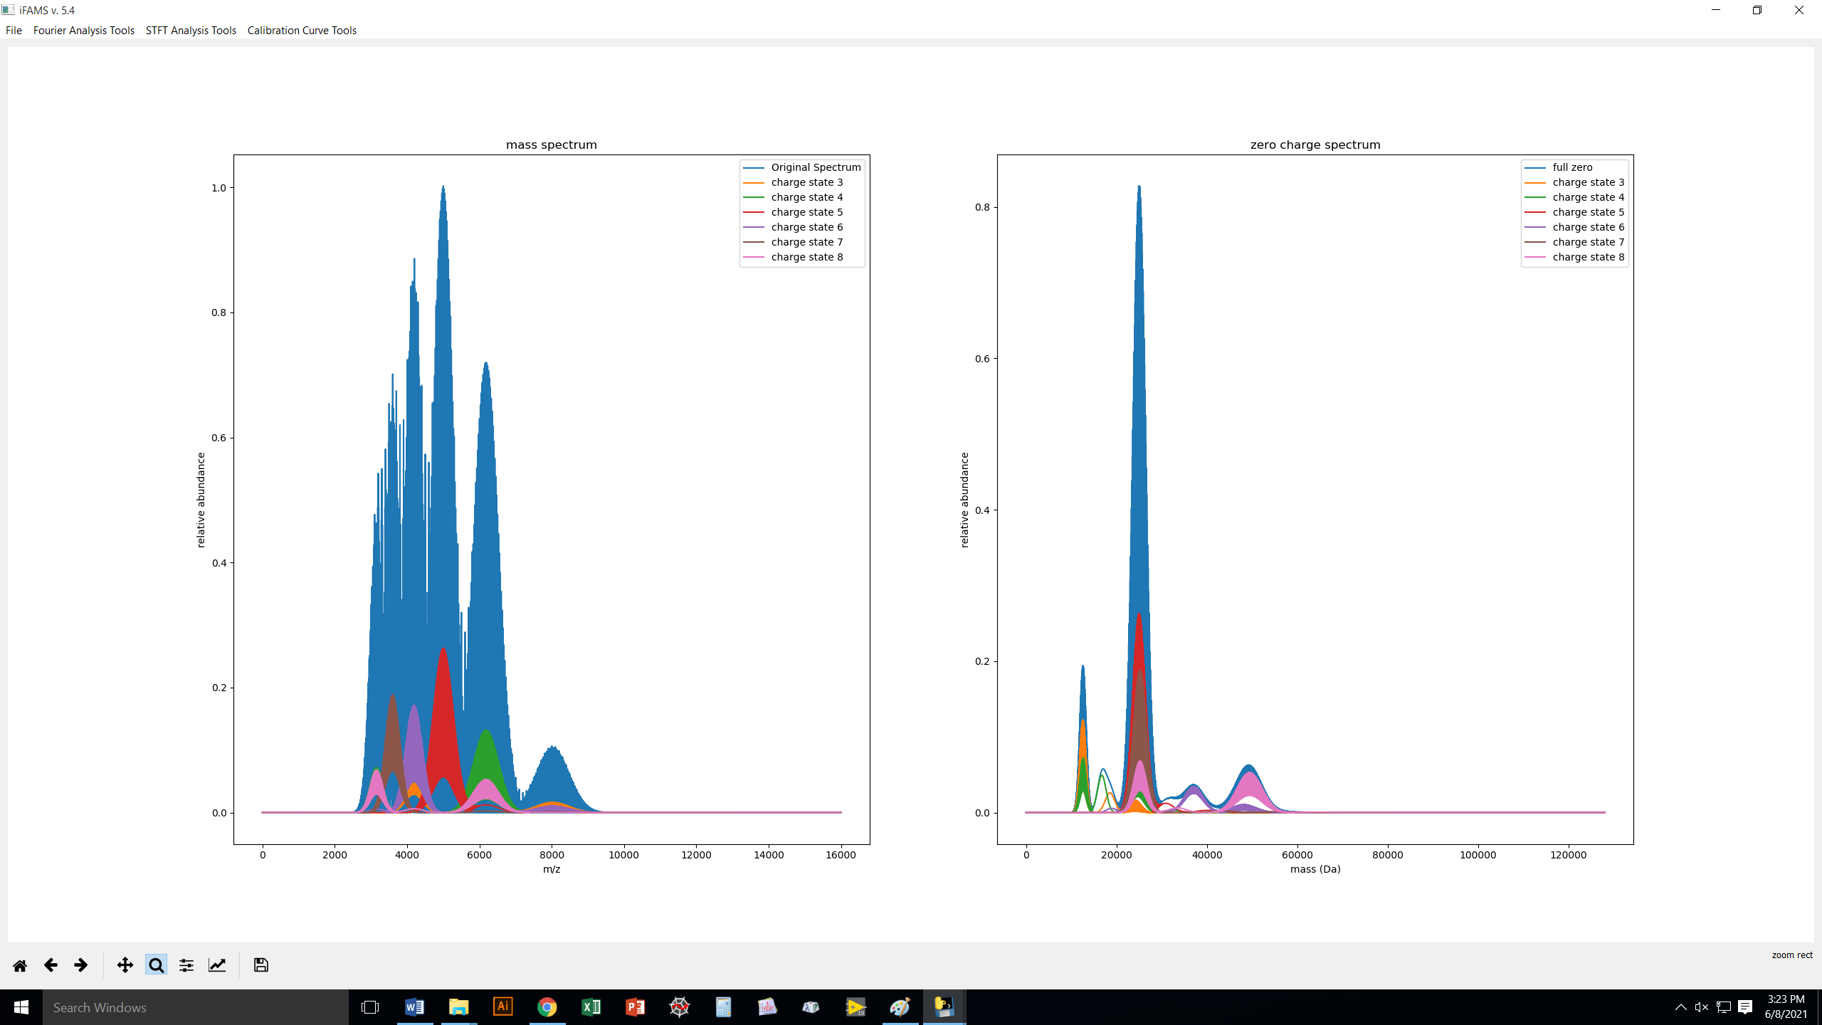
We now have much better resolution
in the deconvolved spectrum,
…BUT we also have some artifacts
due to harmonics.

Slide 34
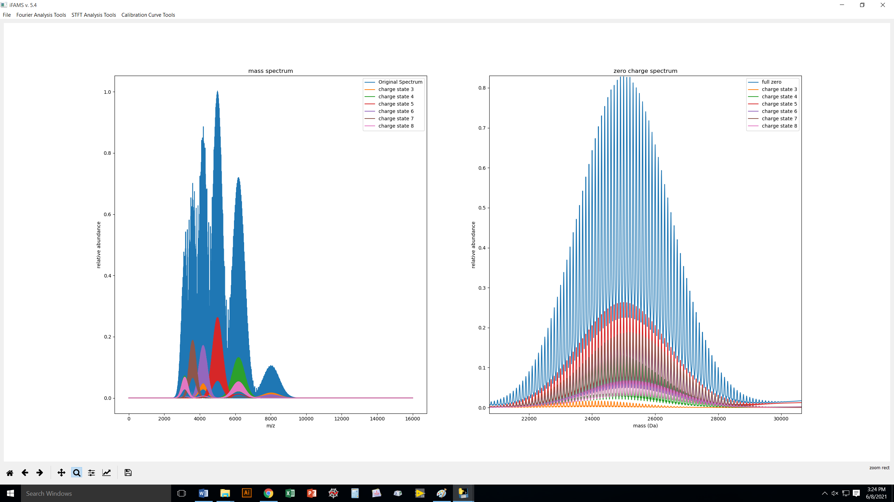
Here’s a zoom of our results.
It is essentially exactly correct.
If you like these results, you can
export them.

Slide 35
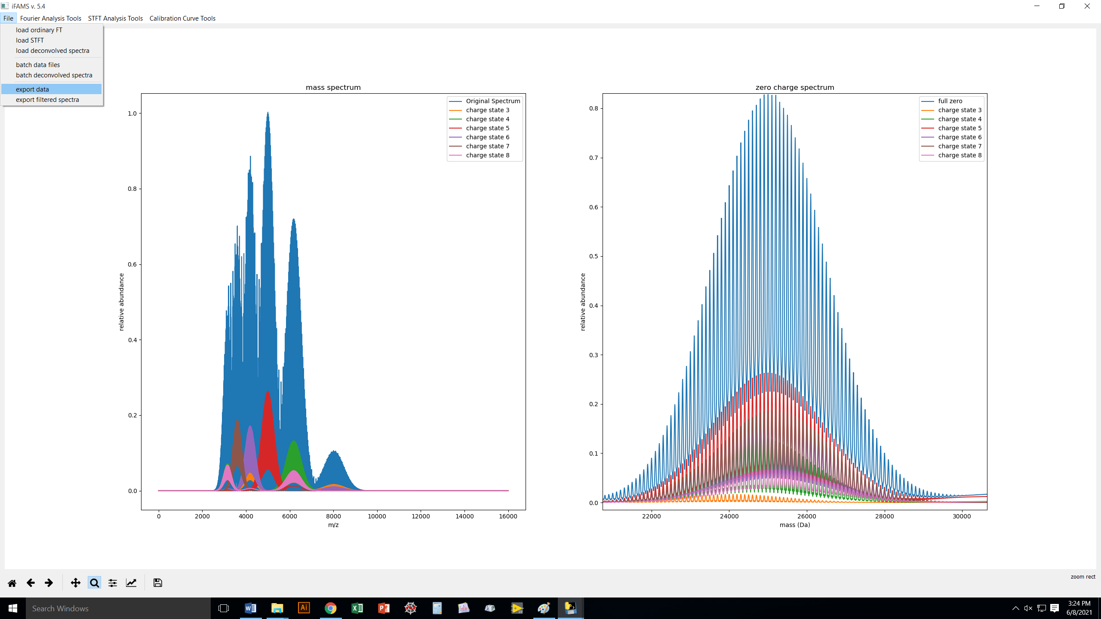

Slide 36
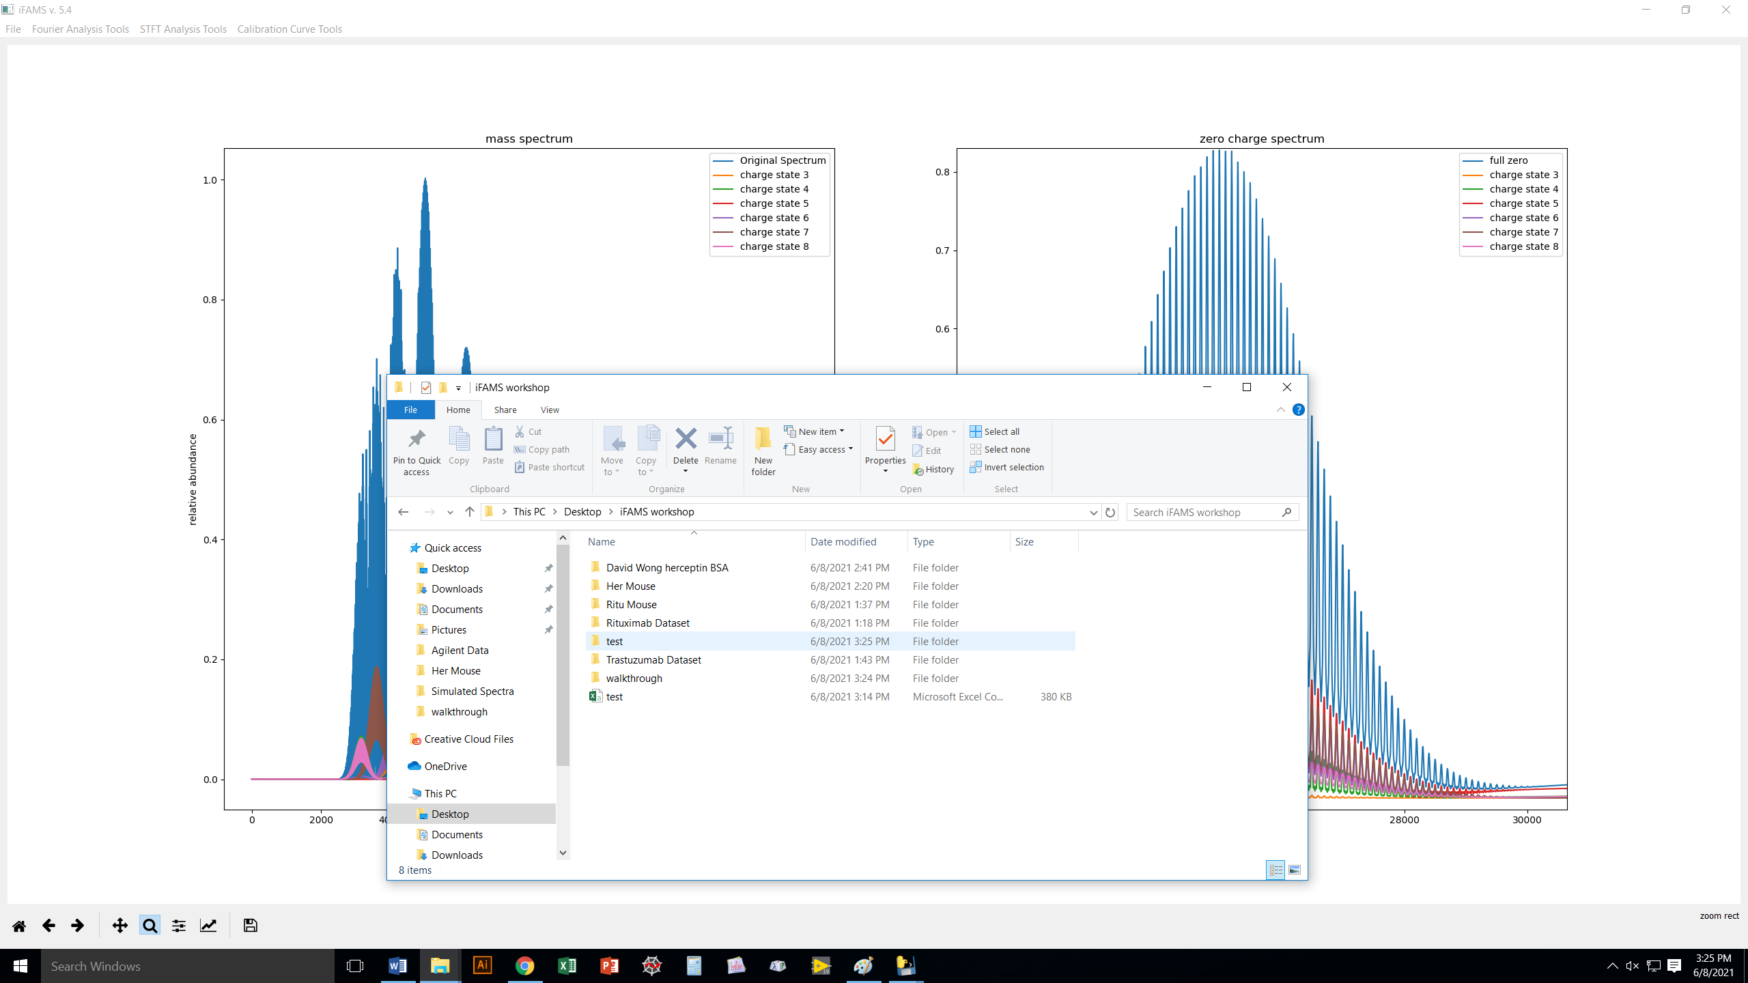
A new folder has been created
with all of your results so far.

Slide 37
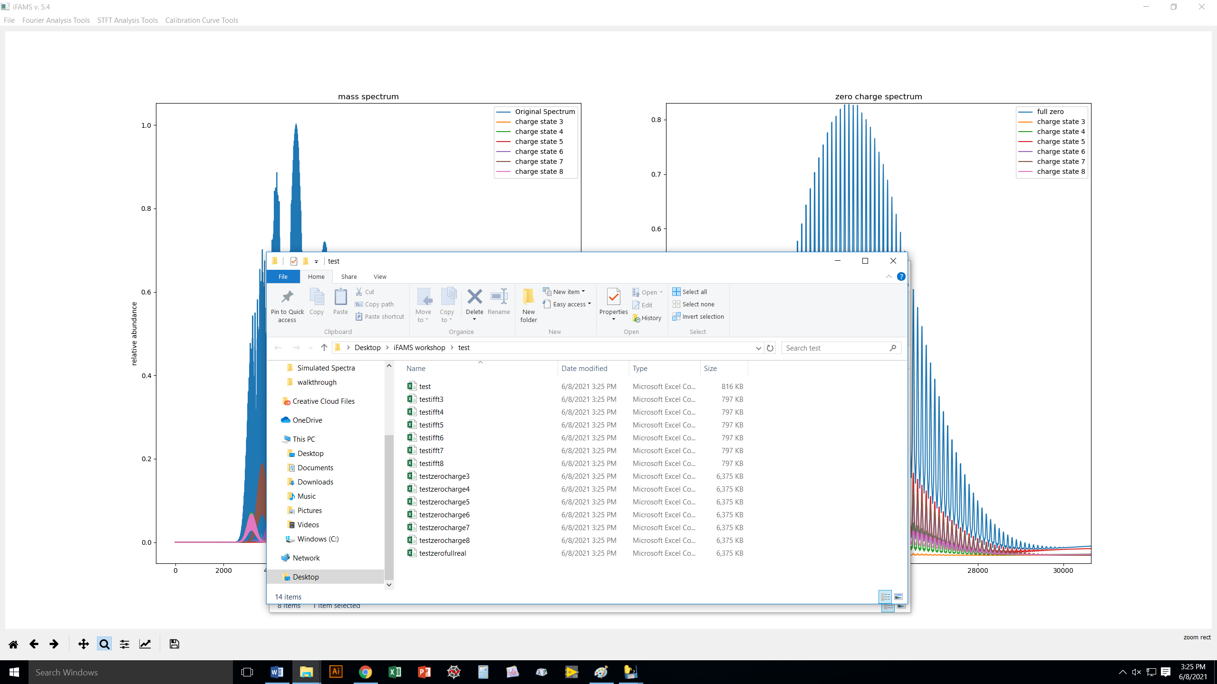
The results are labeled by type:
“ifft” = inverse Fourier transform data
= charge-state-specific mass spectrum;
“zerocharge” = contribution to “zero charge”
mass spectrum
and by charge state (3,4,5,6,7,8+, here)

Slide 38
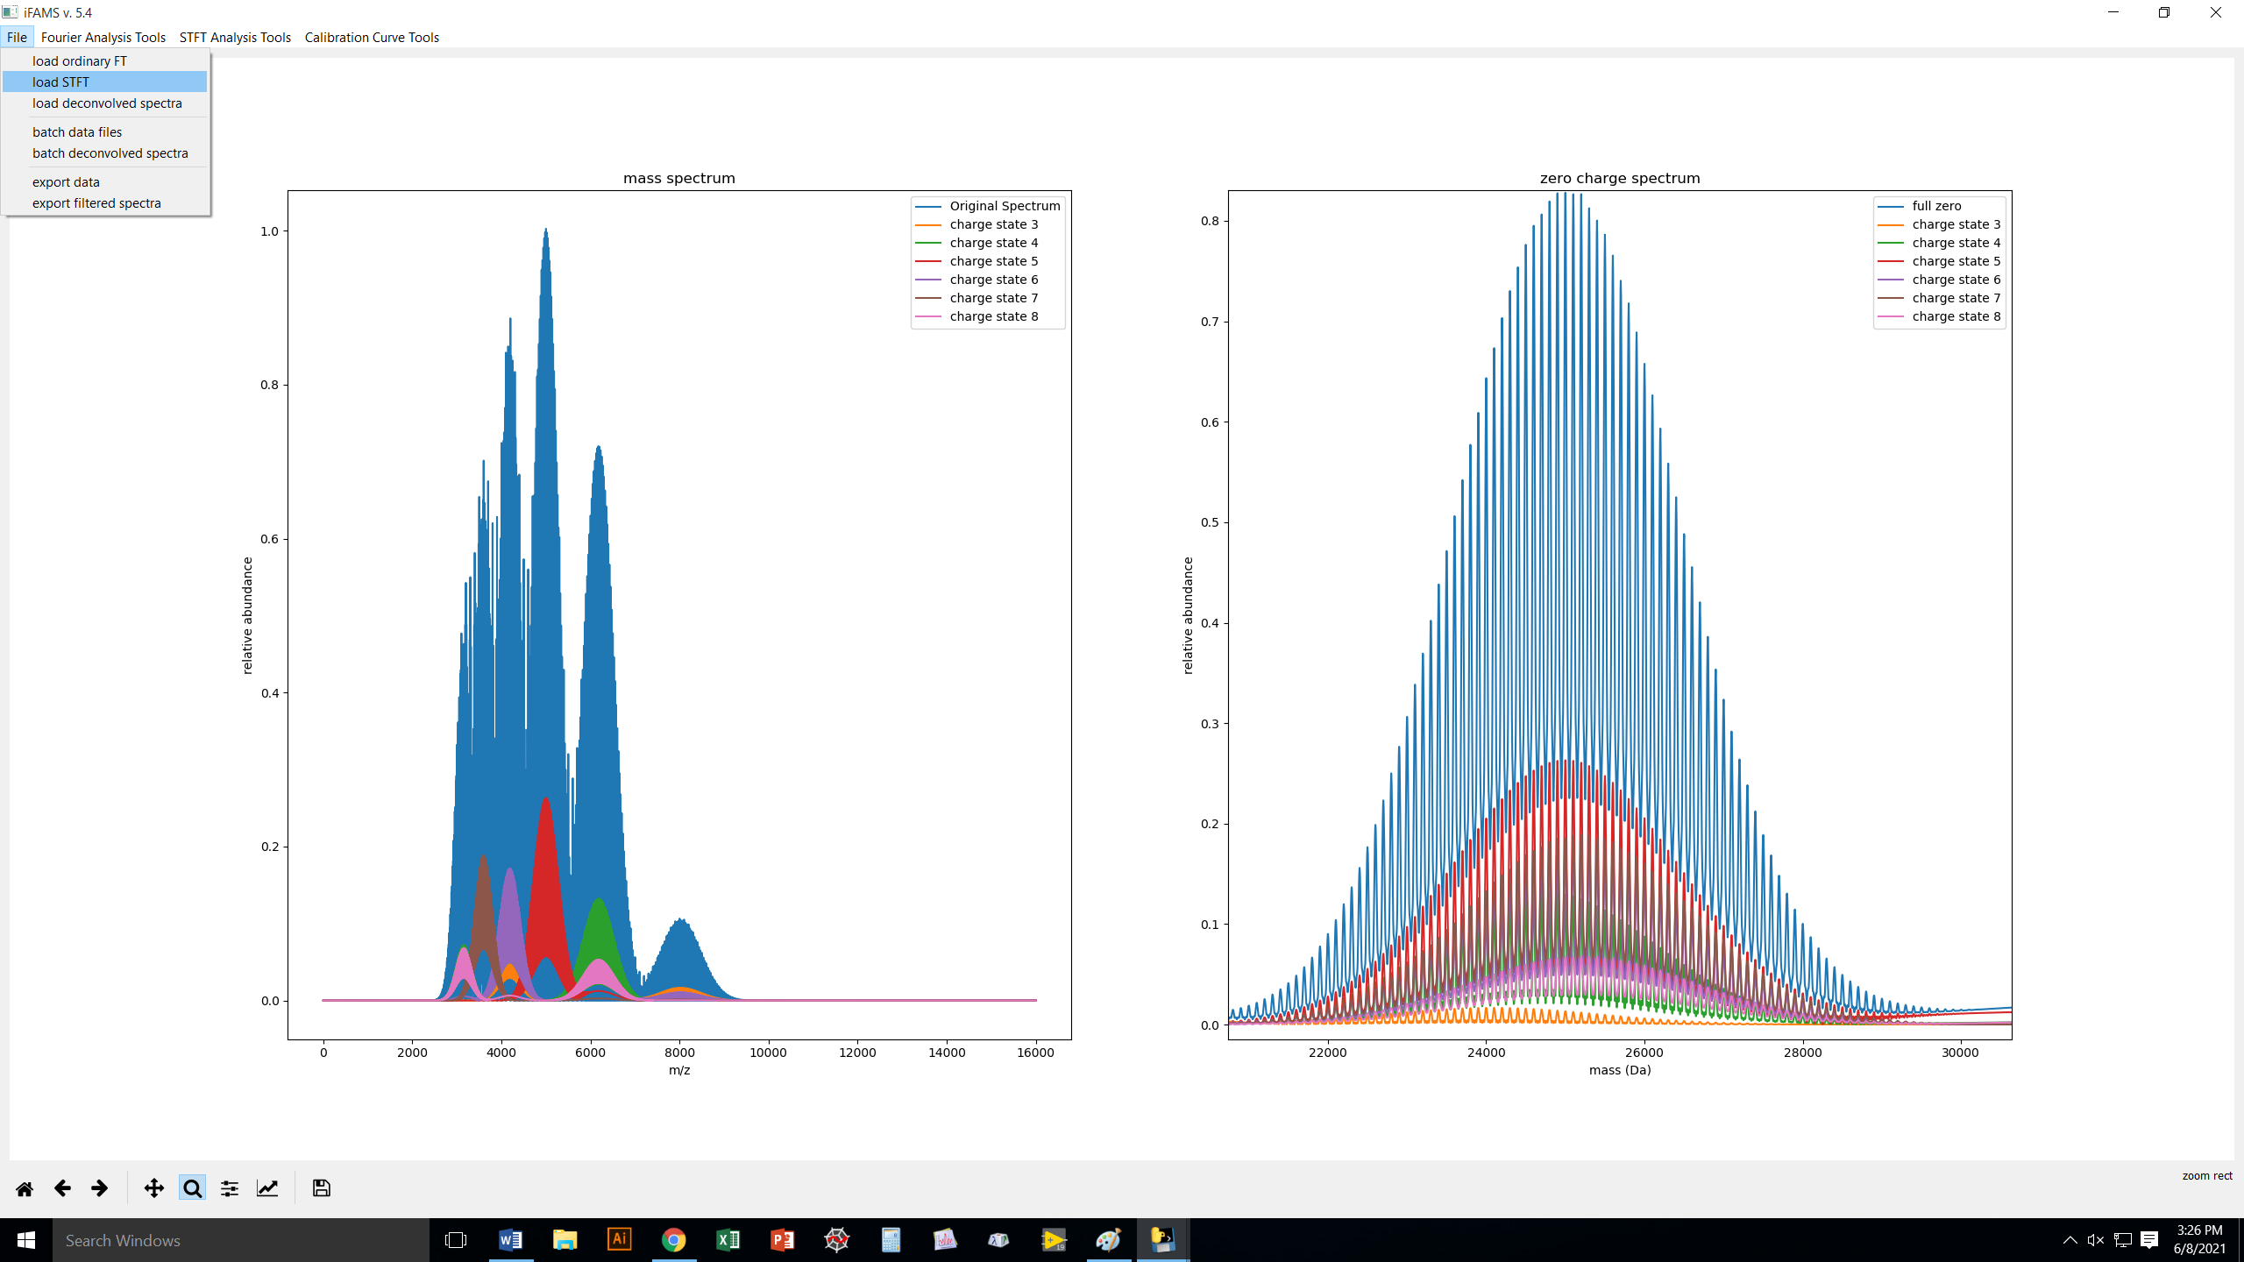
But what if you want higher selection capabilities, e.g., to eliminate harmonic artifacts or exclude a
contaminant? Try Gábor Transform (STFT)!

Slide 39
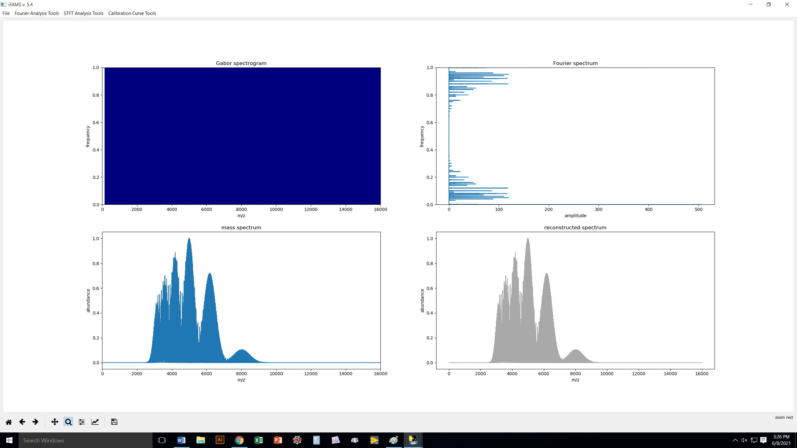
Sometimes, you can’t see the peaks
in the Gabor spectrogram right away.
need to adjust the color scale!
This is identical to the FT spectrum
from the Fourier Analysis Tool,
just turned sideways, because
frequency is now our y-axis
This is just the raw
mass spectrum, and
it will stay here.
This is where our
GT results will start
to appear as we go.

Slide 40
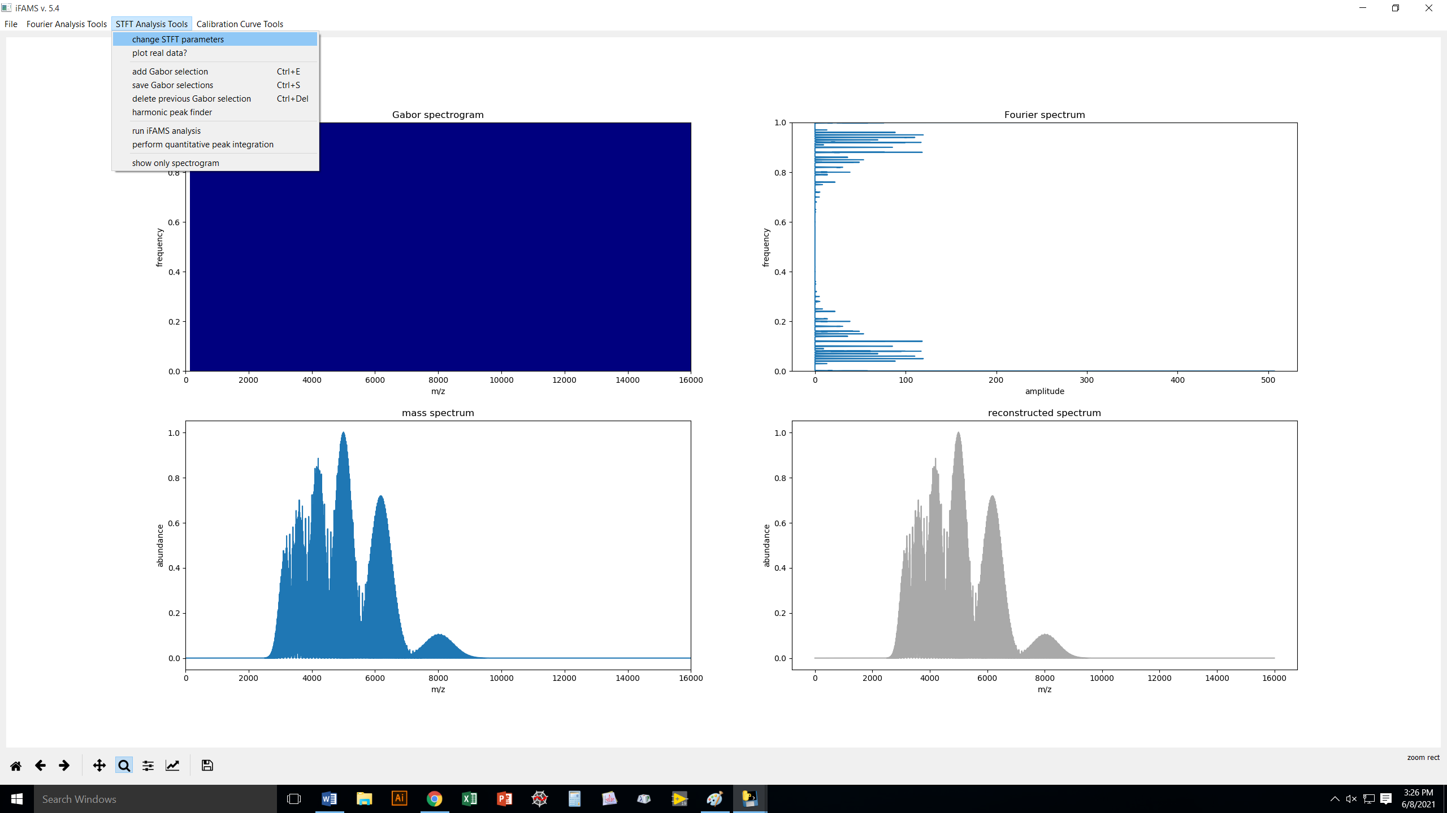

Slide 41
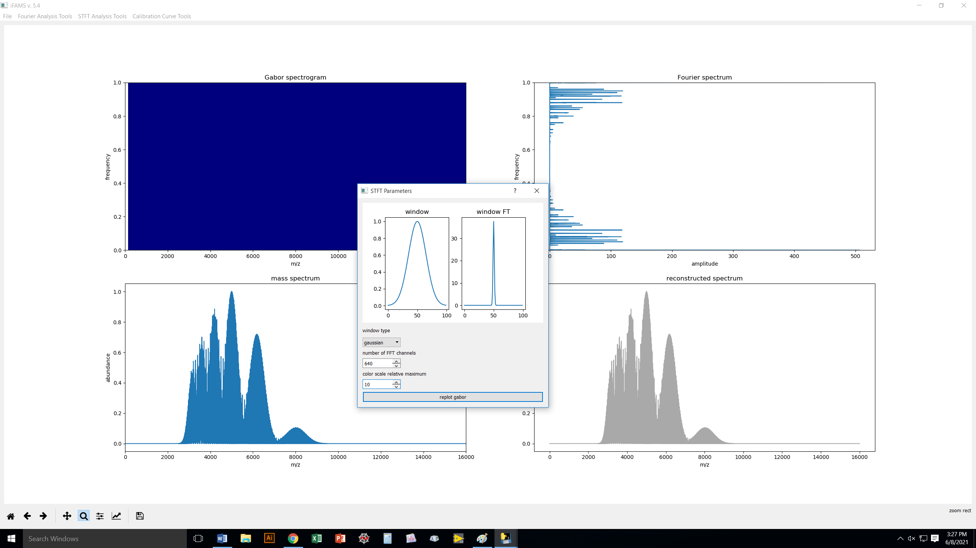

Slide 42
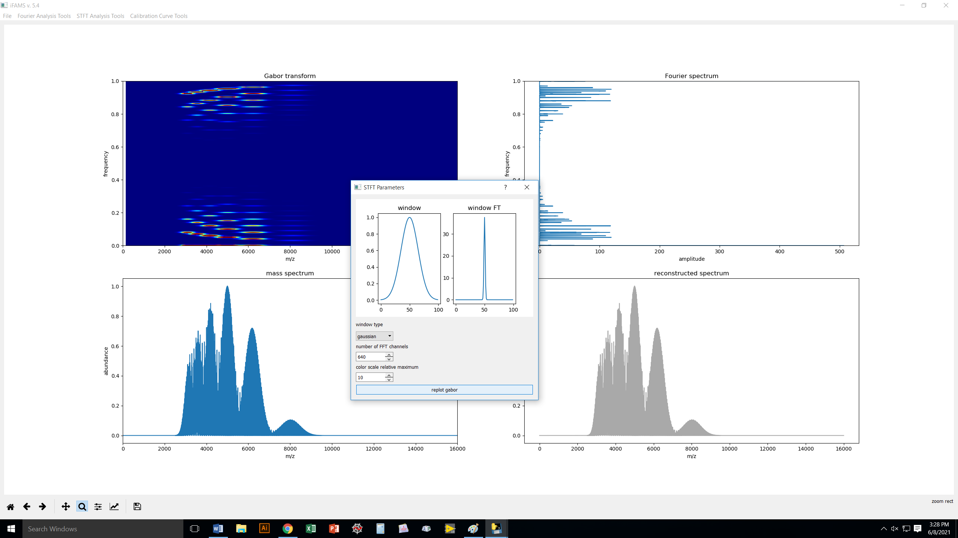
There they are! Note that
the upper peaks are
just a reflection of the bottom
peaks (you can ignore them).

Slide 43

Changing color max
may make peaks
easier to see.

Slide 44

Let’s also try
changing the
freq resolution.

Slide 45
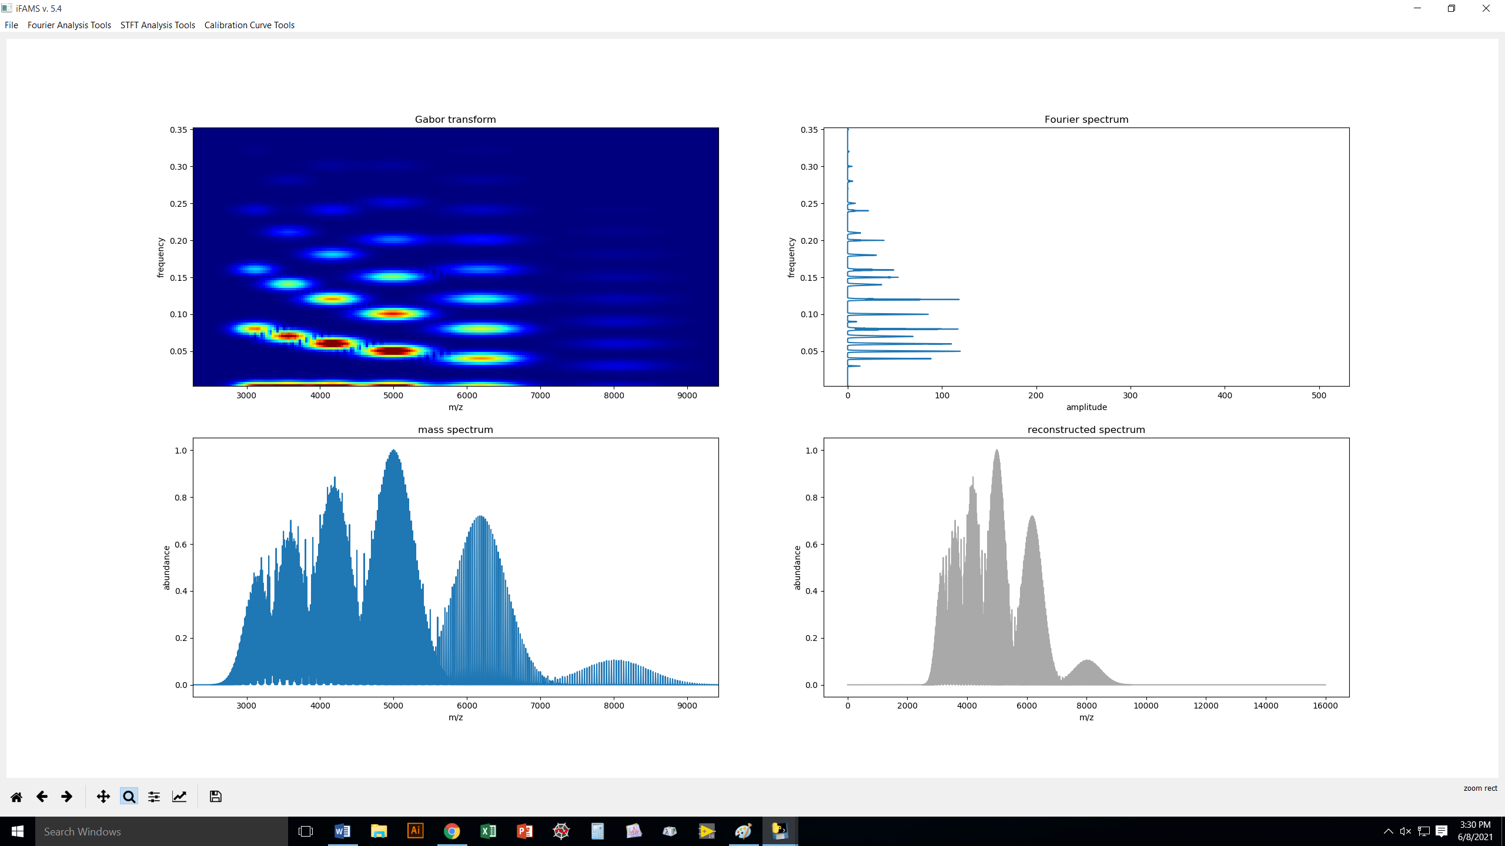
Now that we like what we see, we can zoom in to the region of interest (use the magnifying glass!
you can always undo your zoom by pressing the ← arrow or go back to the original zoom with the “home” button).

Slide 46

We are ready to ANALYZE the data. You need to UNCLICK the magnifying glass button first!

Slide 47
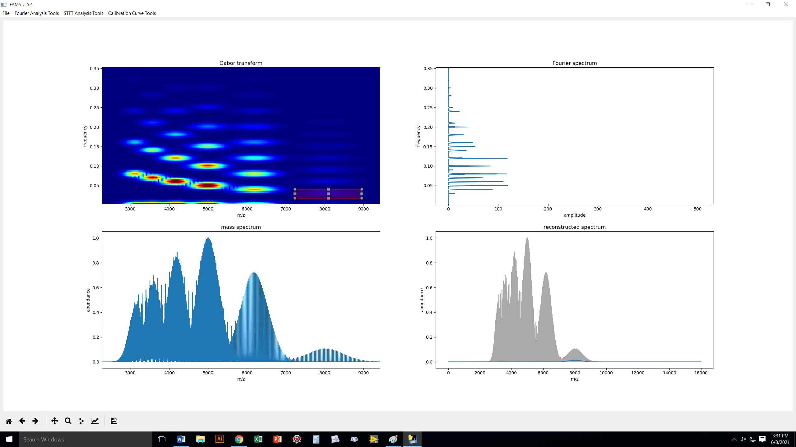
Left-click and drag to draw a box around a fundamental you want to analyze. If you want to modify your box, click
and drag the corners until you are happy with it. Once done, hit Ctrl-E to add it to the developing spectrum.

Slide 48

If you are ready to move on to the next charge state, hit Ctrl-S to save your work. The box will acquire a thicker border
when you have done this.
Down here, you can
already see your
reconstruction
“developing”.

Slide 49
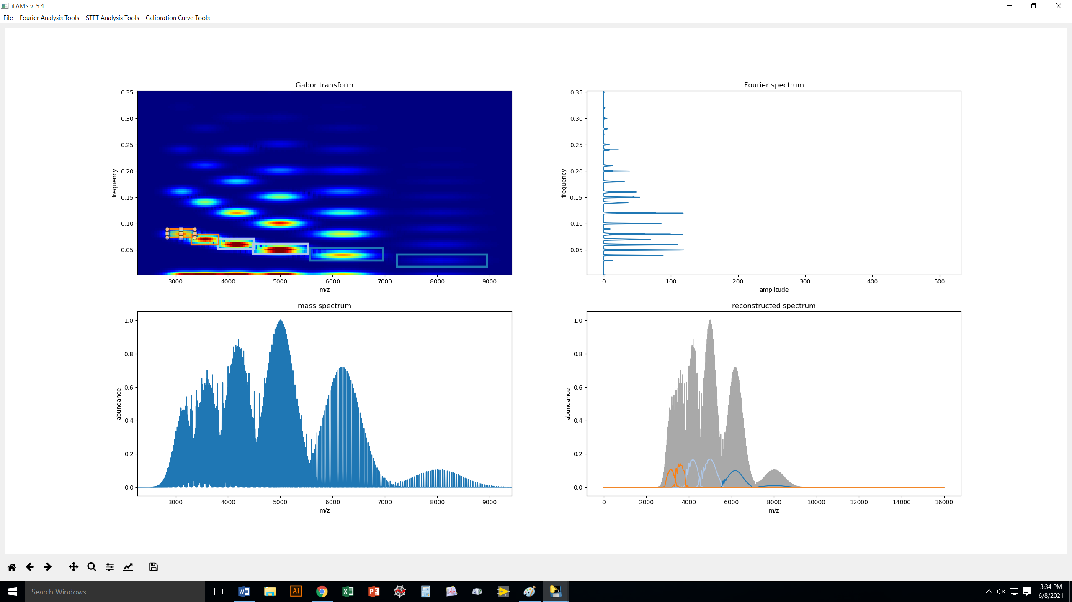
Here, I’ve selected and saved each of the
fundamentals. Note how the 3/4+
peaks don’t overlap with 6/8+ at all!

Slide 50
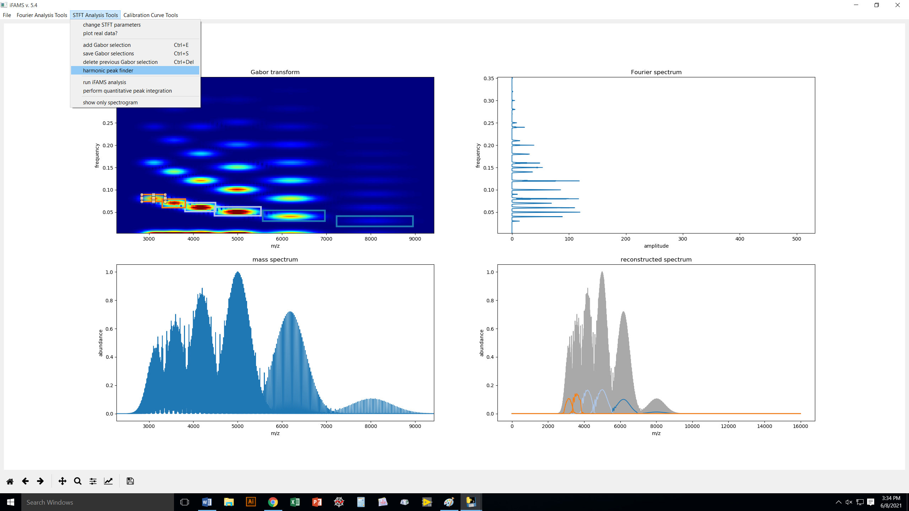
Now that you have picked your fundamentals,
iFAMS can automatically select harmonics
and add them to the deconvolution.

Slide 51

Again, let’s use 4 harmonics.

Slide 52
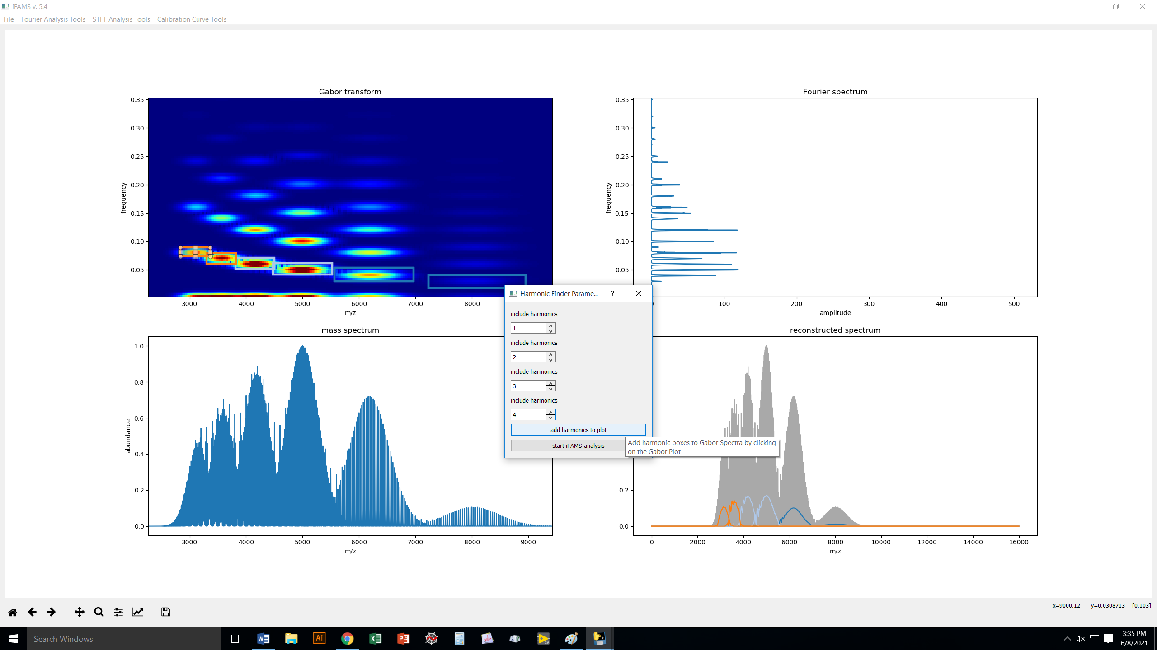

Slide 53
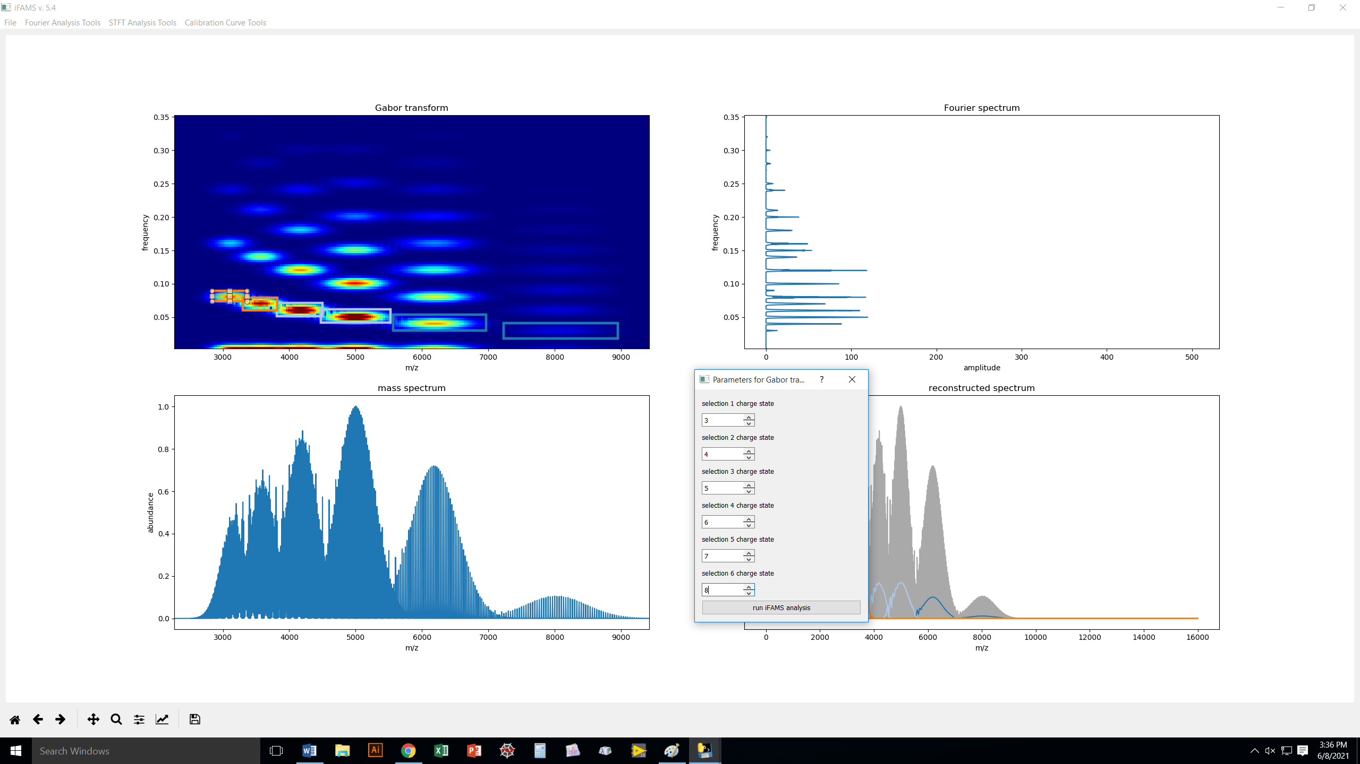
Once you’ve picked the harmonics,
tell iFAMS the charge states in
the order you selected them.

Slide 54
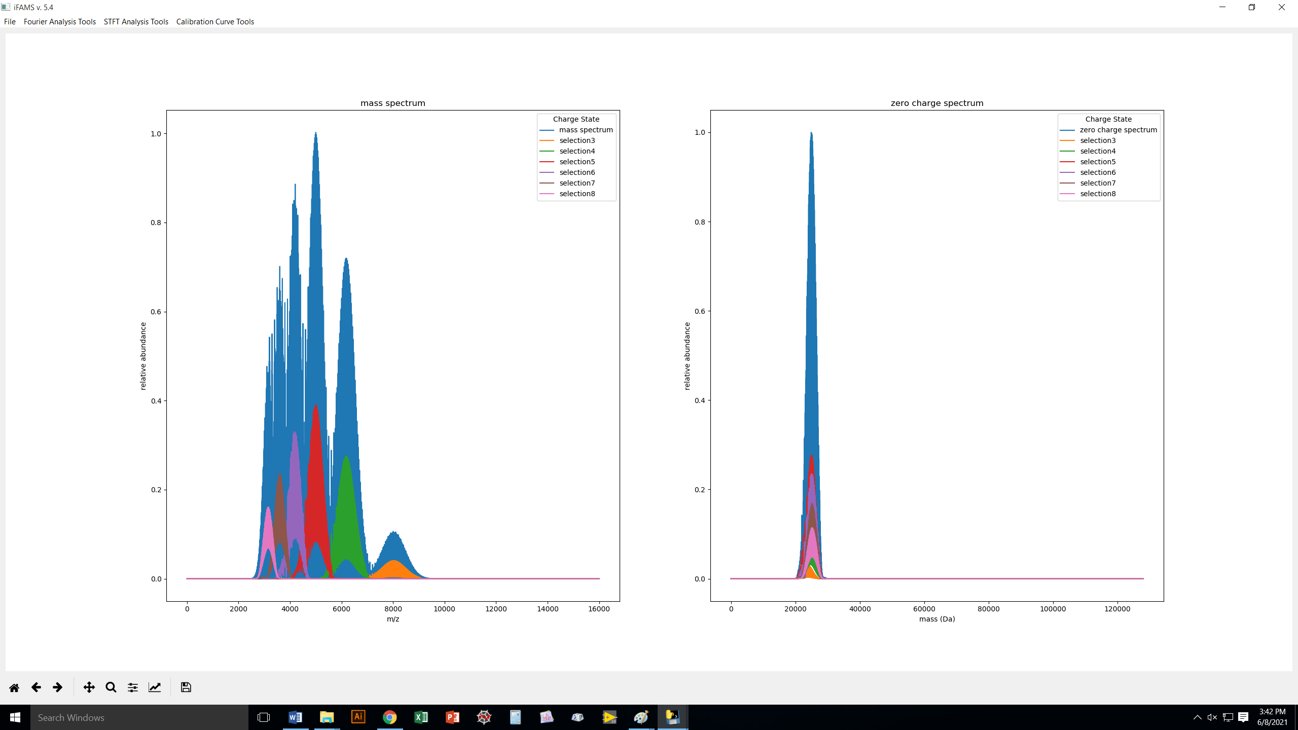
Unlike our earlier FT
analysis, GT analysis
has NO harmonic artifacts!
(Recall, that happened because
we are in a deliberately hard
situation with low charge states.)

Slide 55
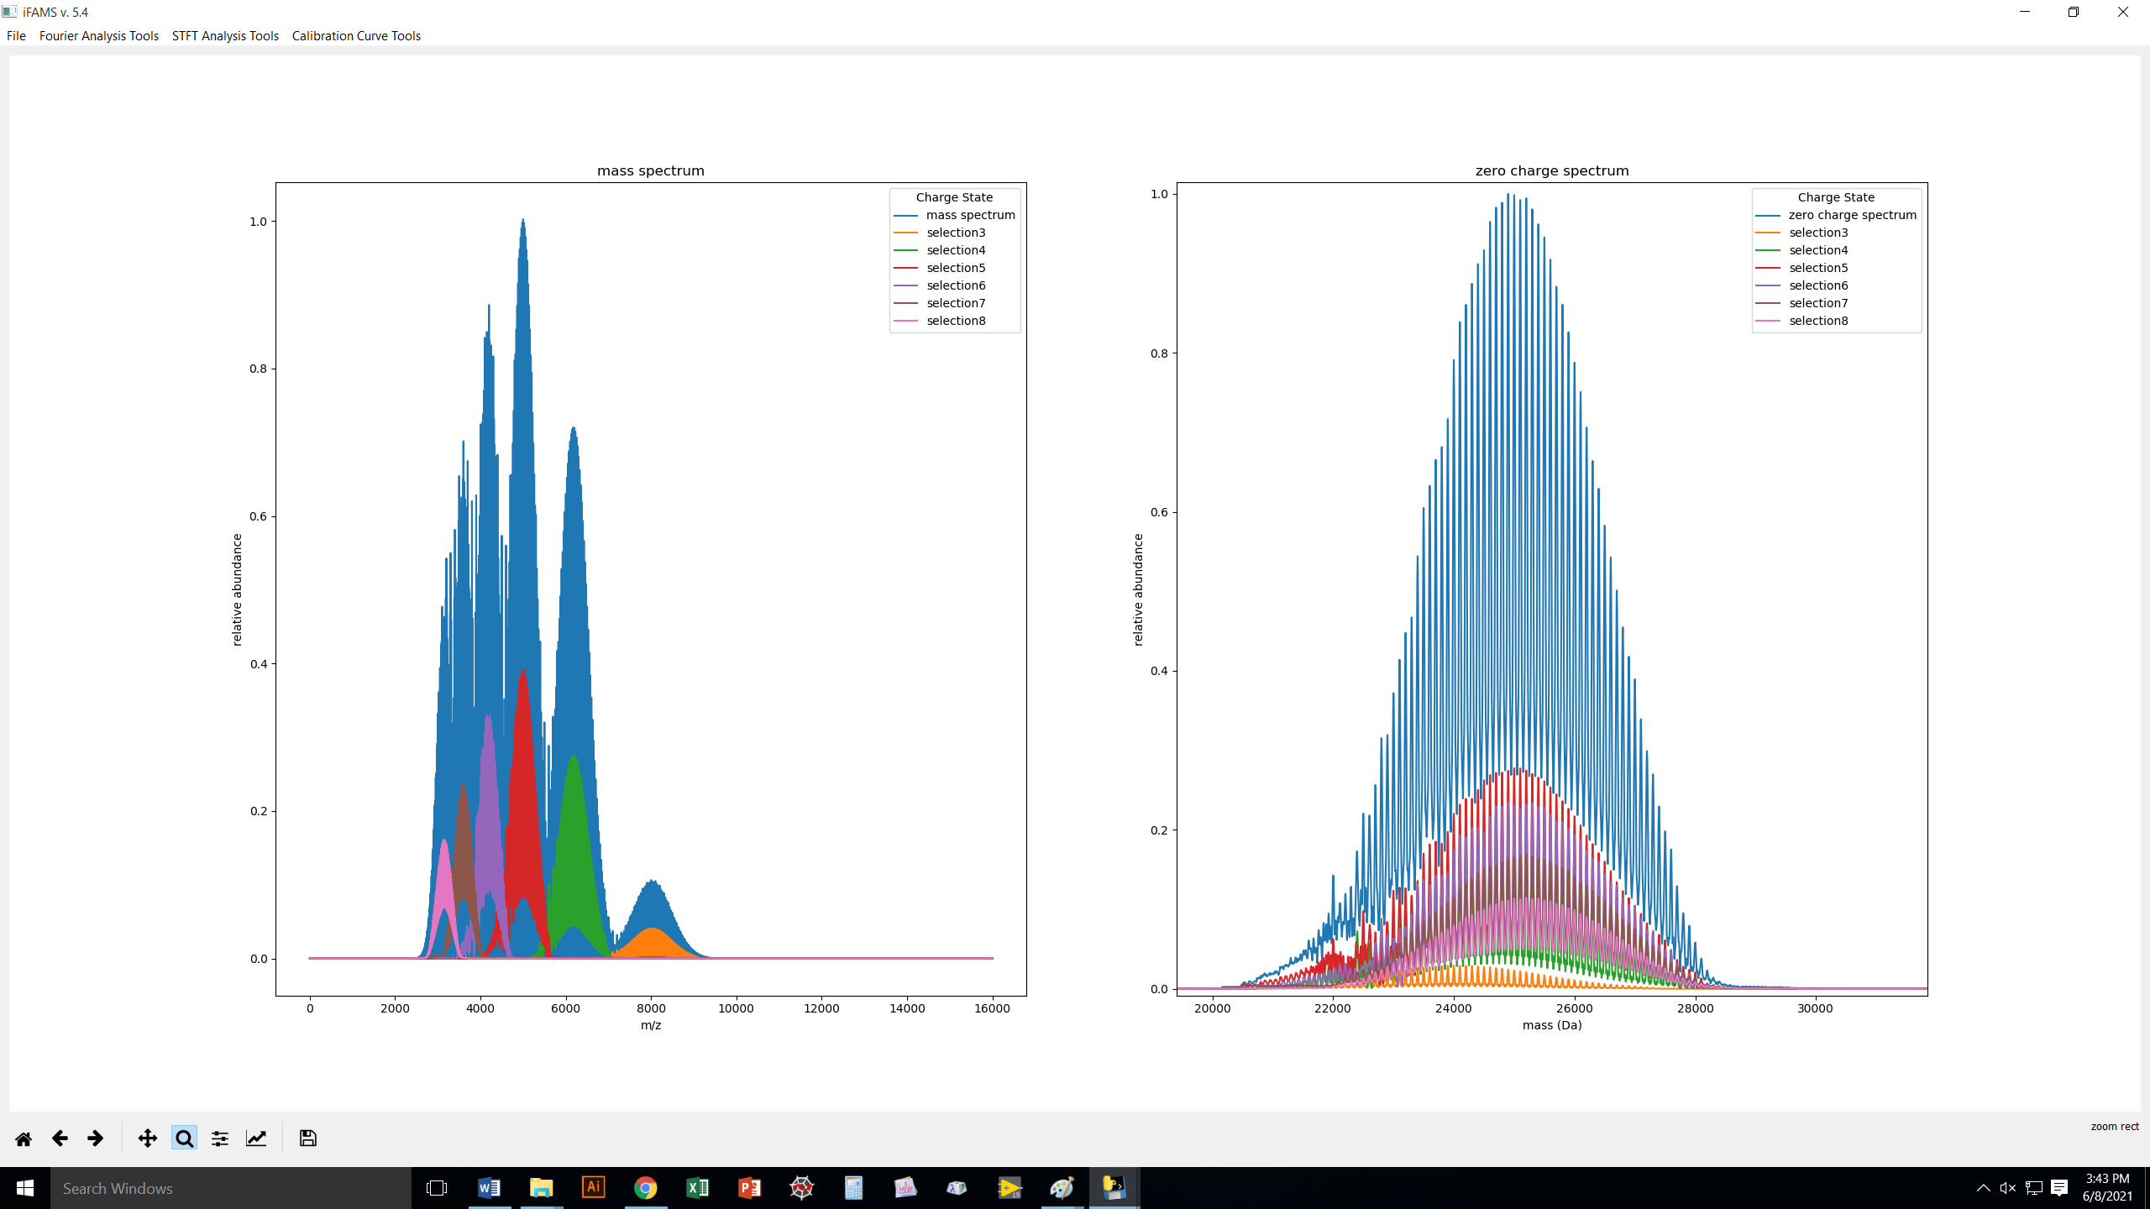
Here, I have zoomed in.

Slide 56
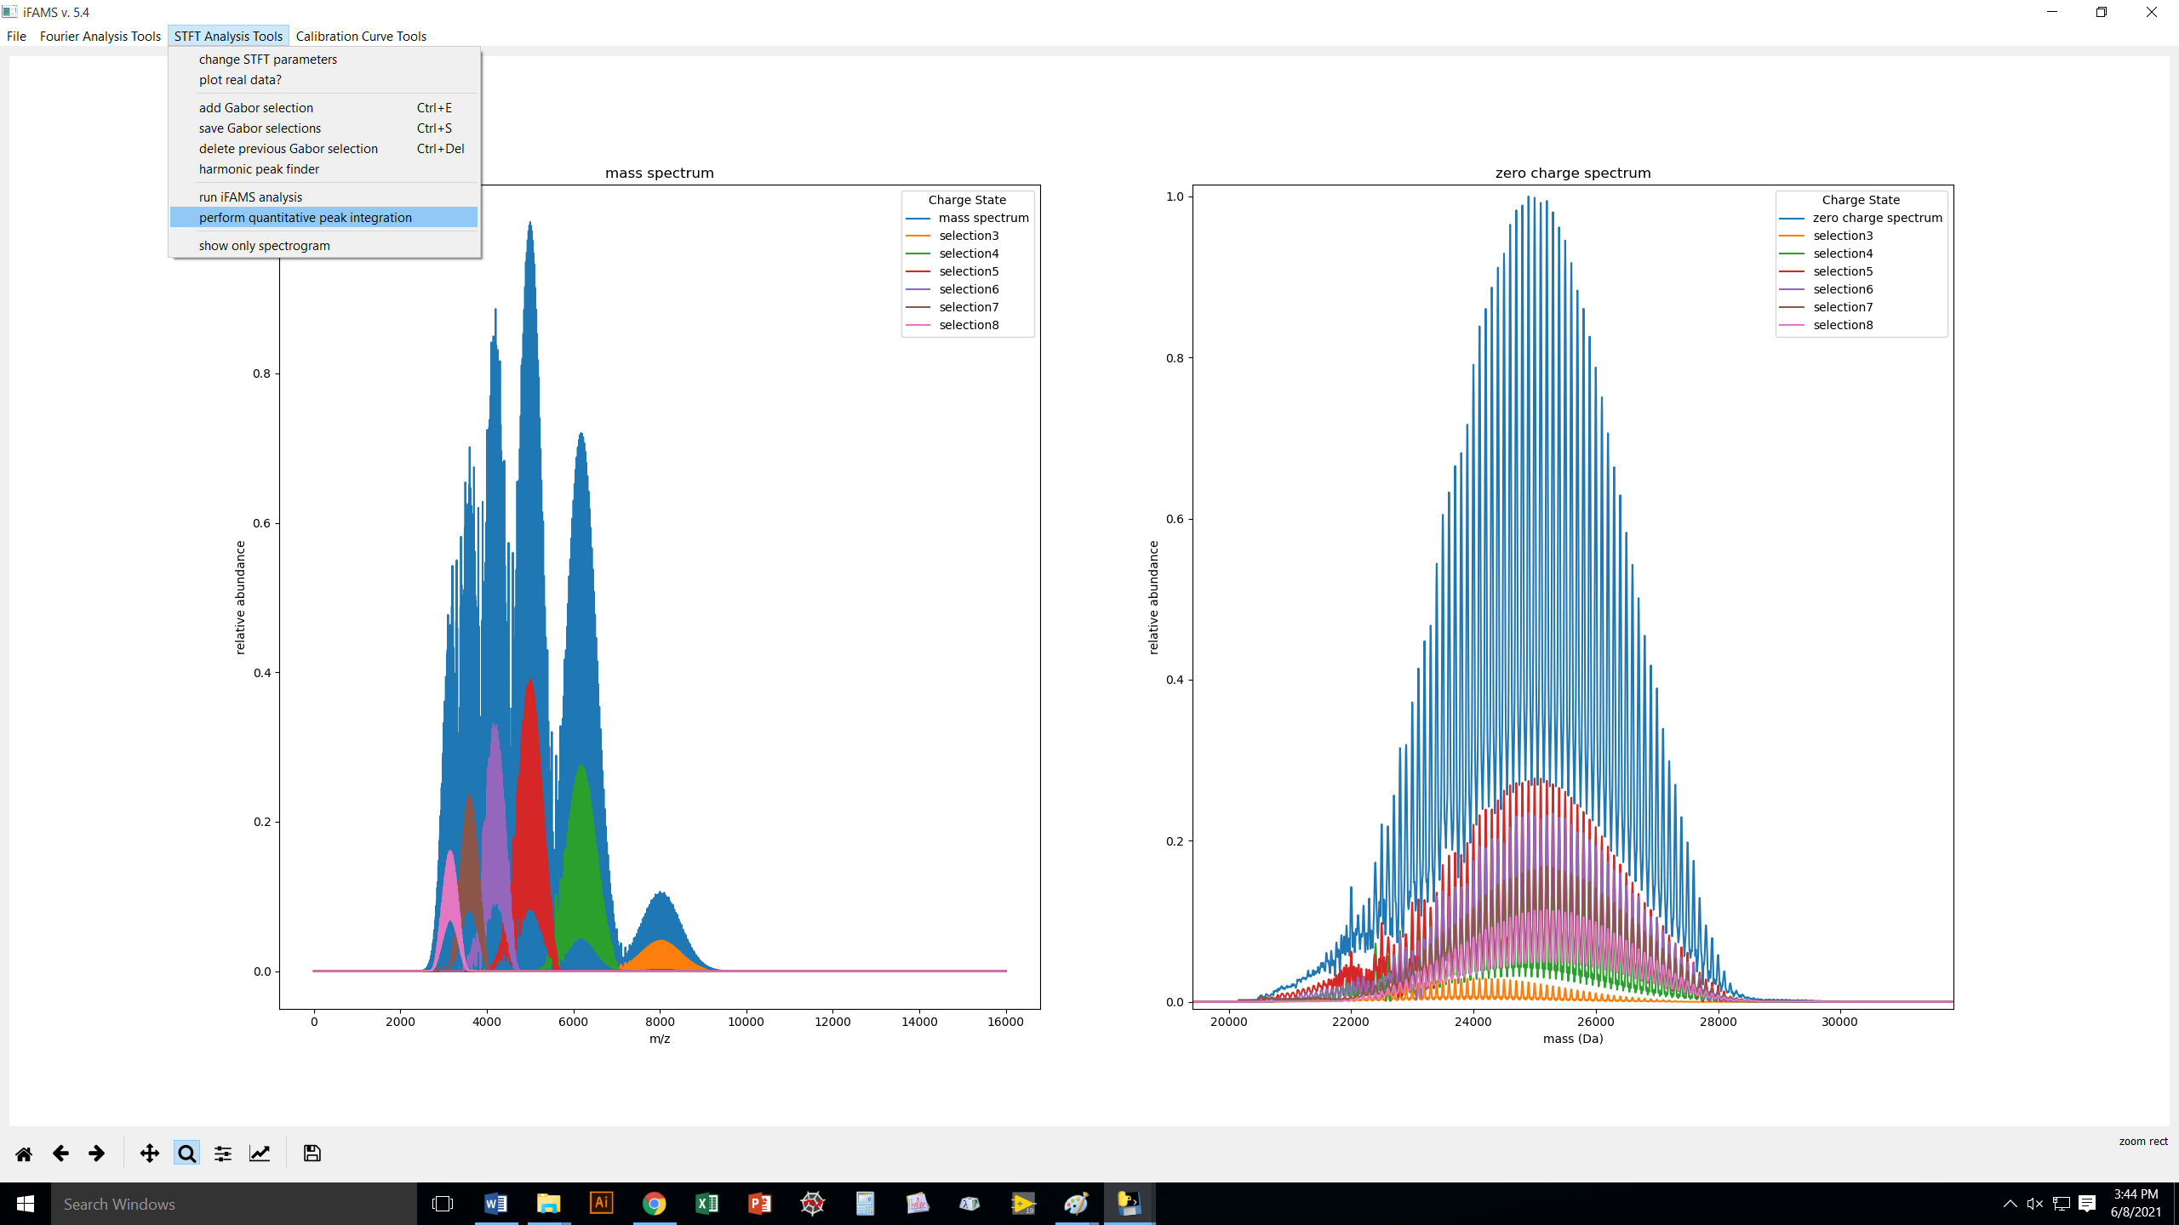
Now, what if you need integrated peak areas and/or heights from your deconvolution?

Slide 57
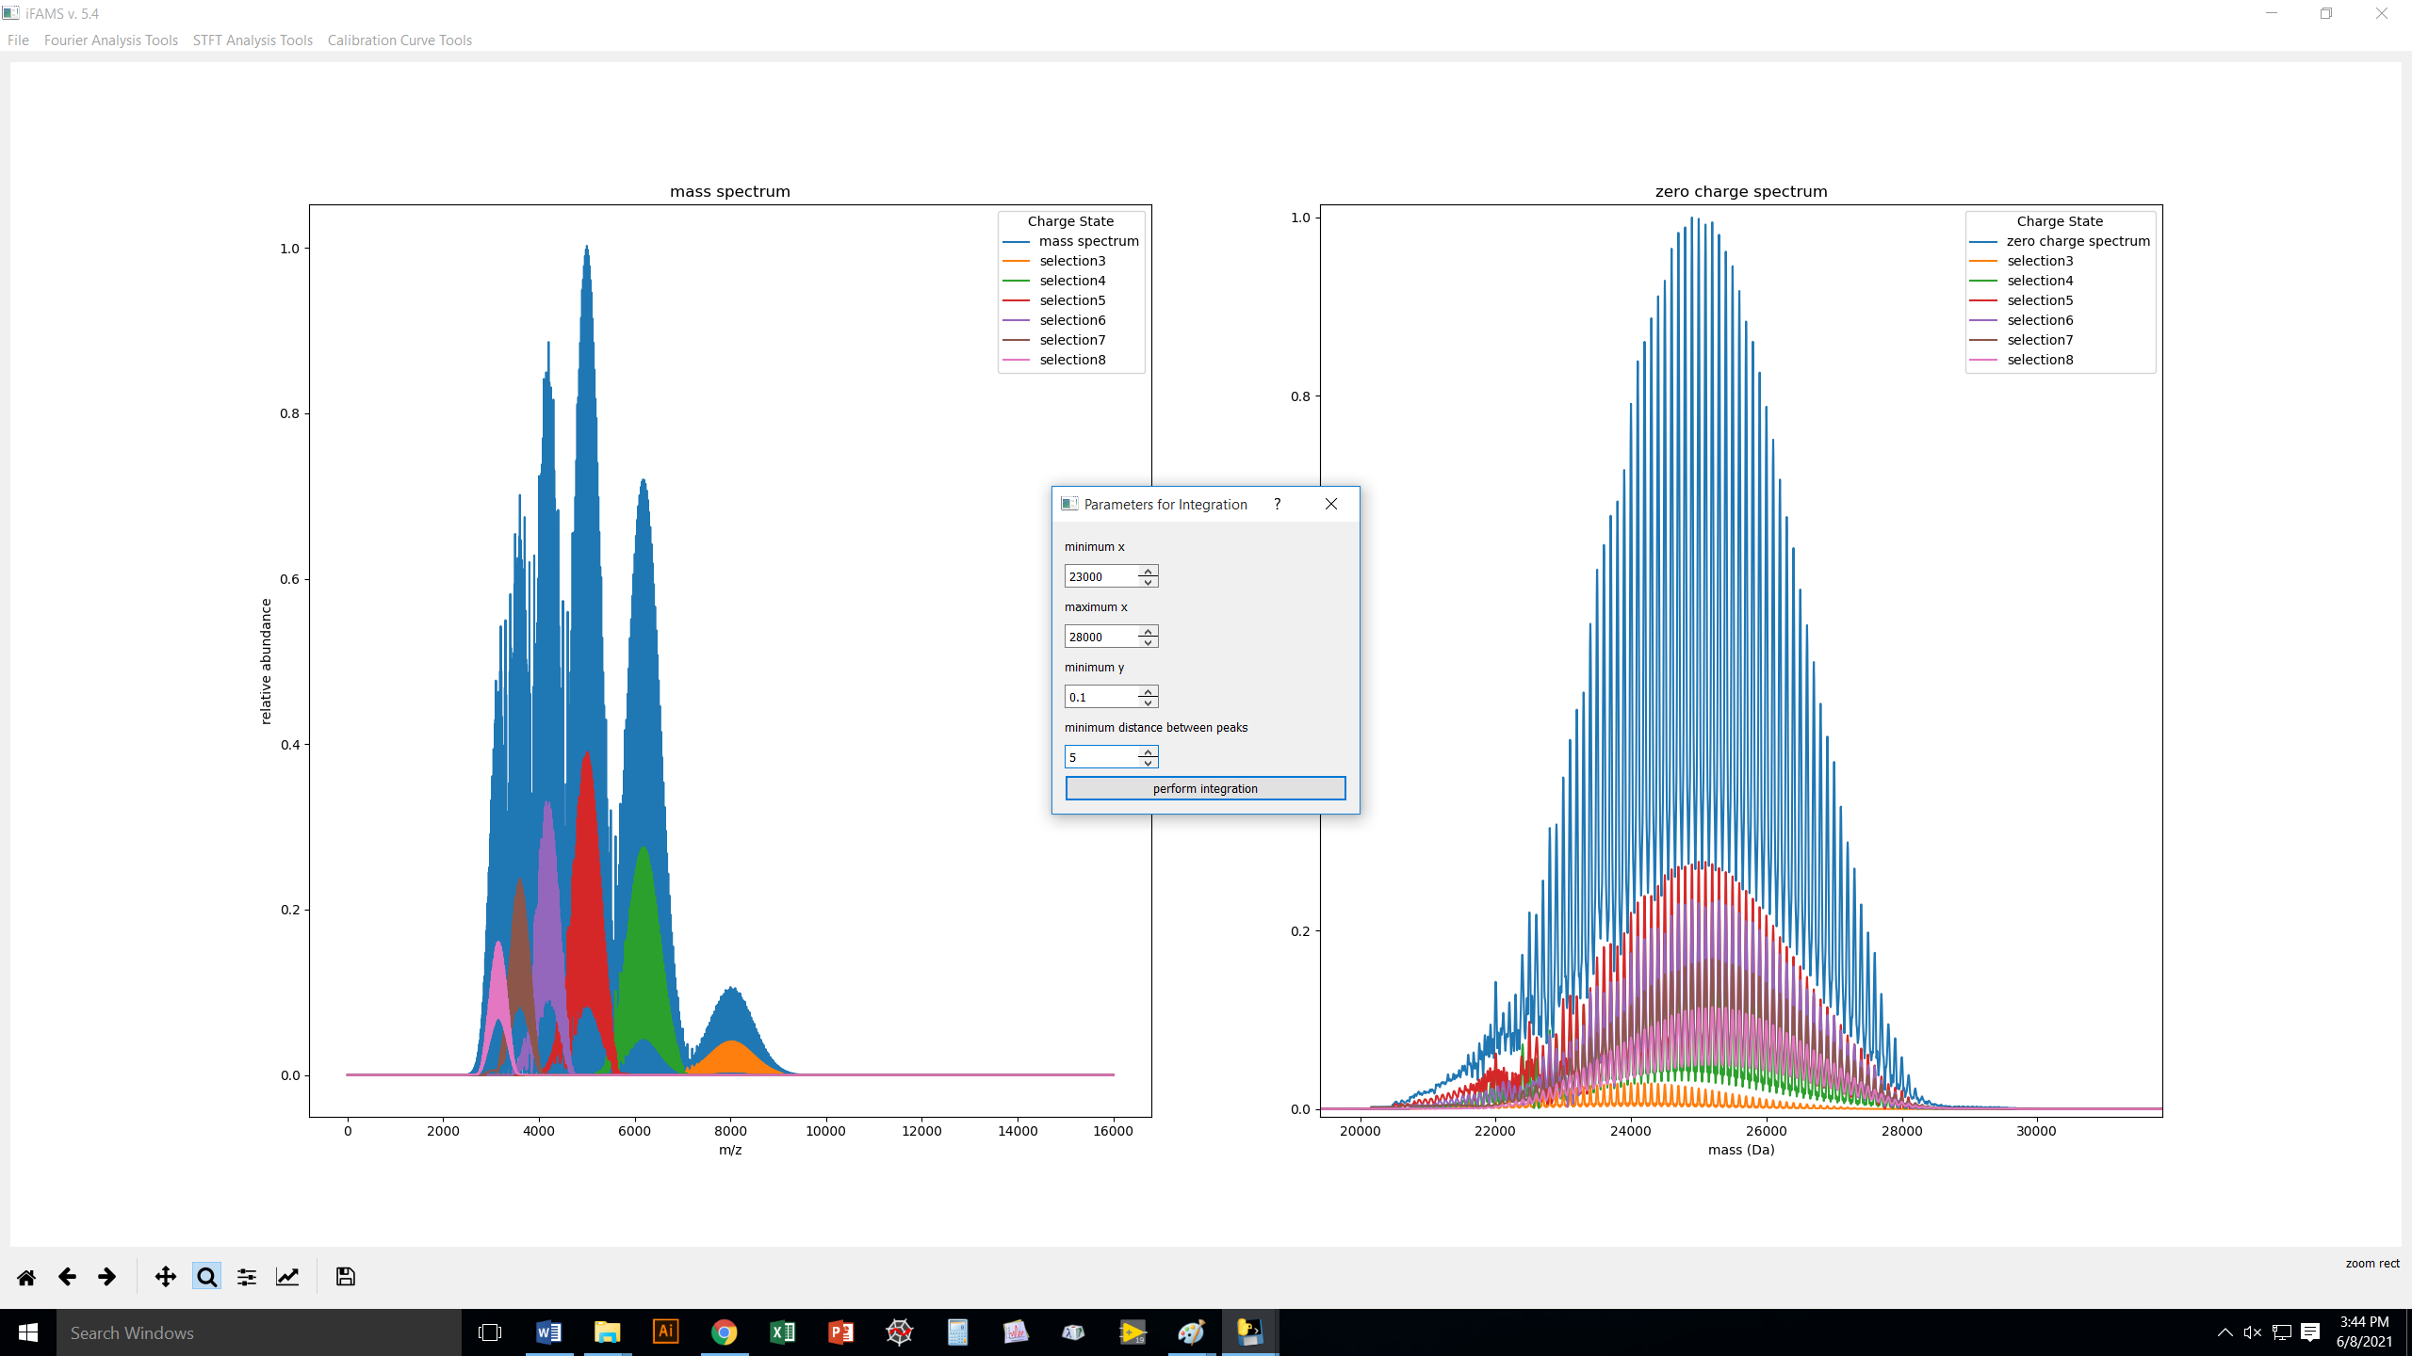
Hopefully, these items are self-explanatory.
The “minimum distance between peaks”
simply helps you deal with any remaining
noise, if need be.

Slide 58
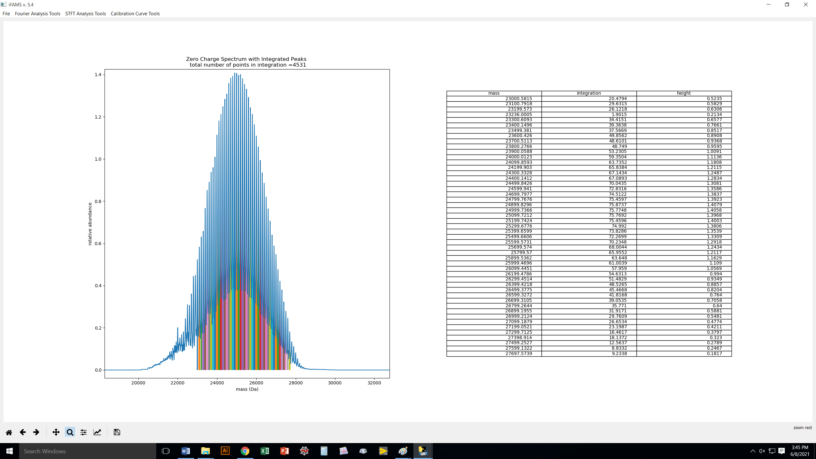
If your list is a lot longer than this, iFAMS will pop out
a scrollable window.

Slide 59
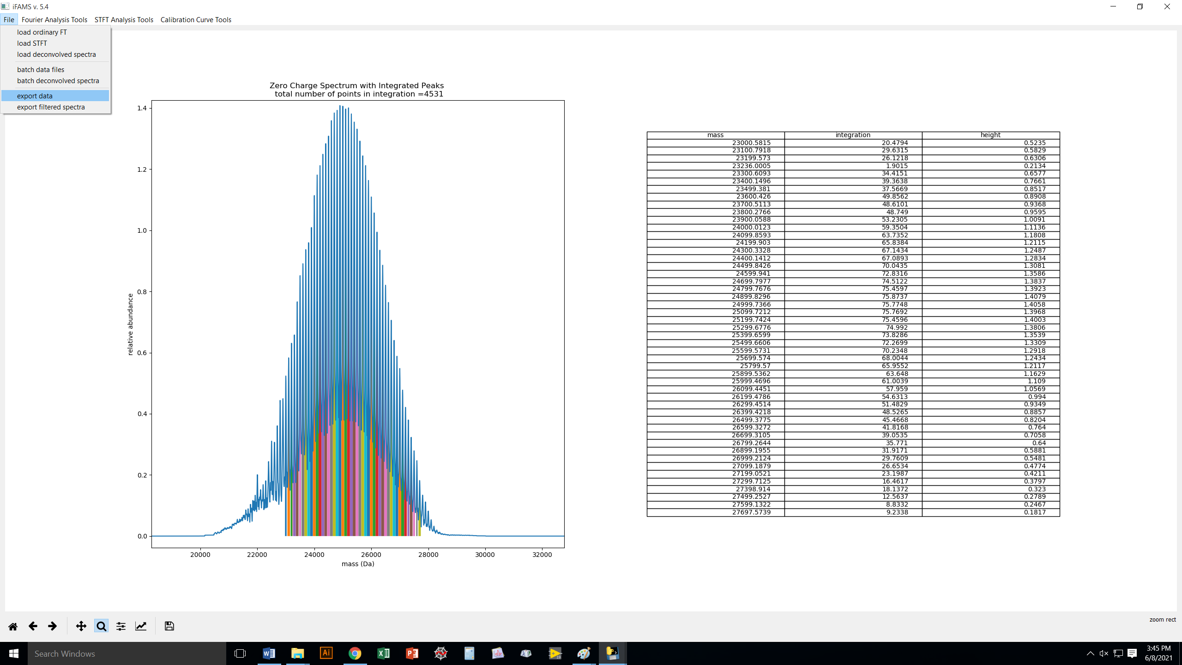
Again, you can export all of your results so far (charge-state-
specific mass spectra, zero-charge deconvolution, and
integrated peak/peak height list).

Slide 60
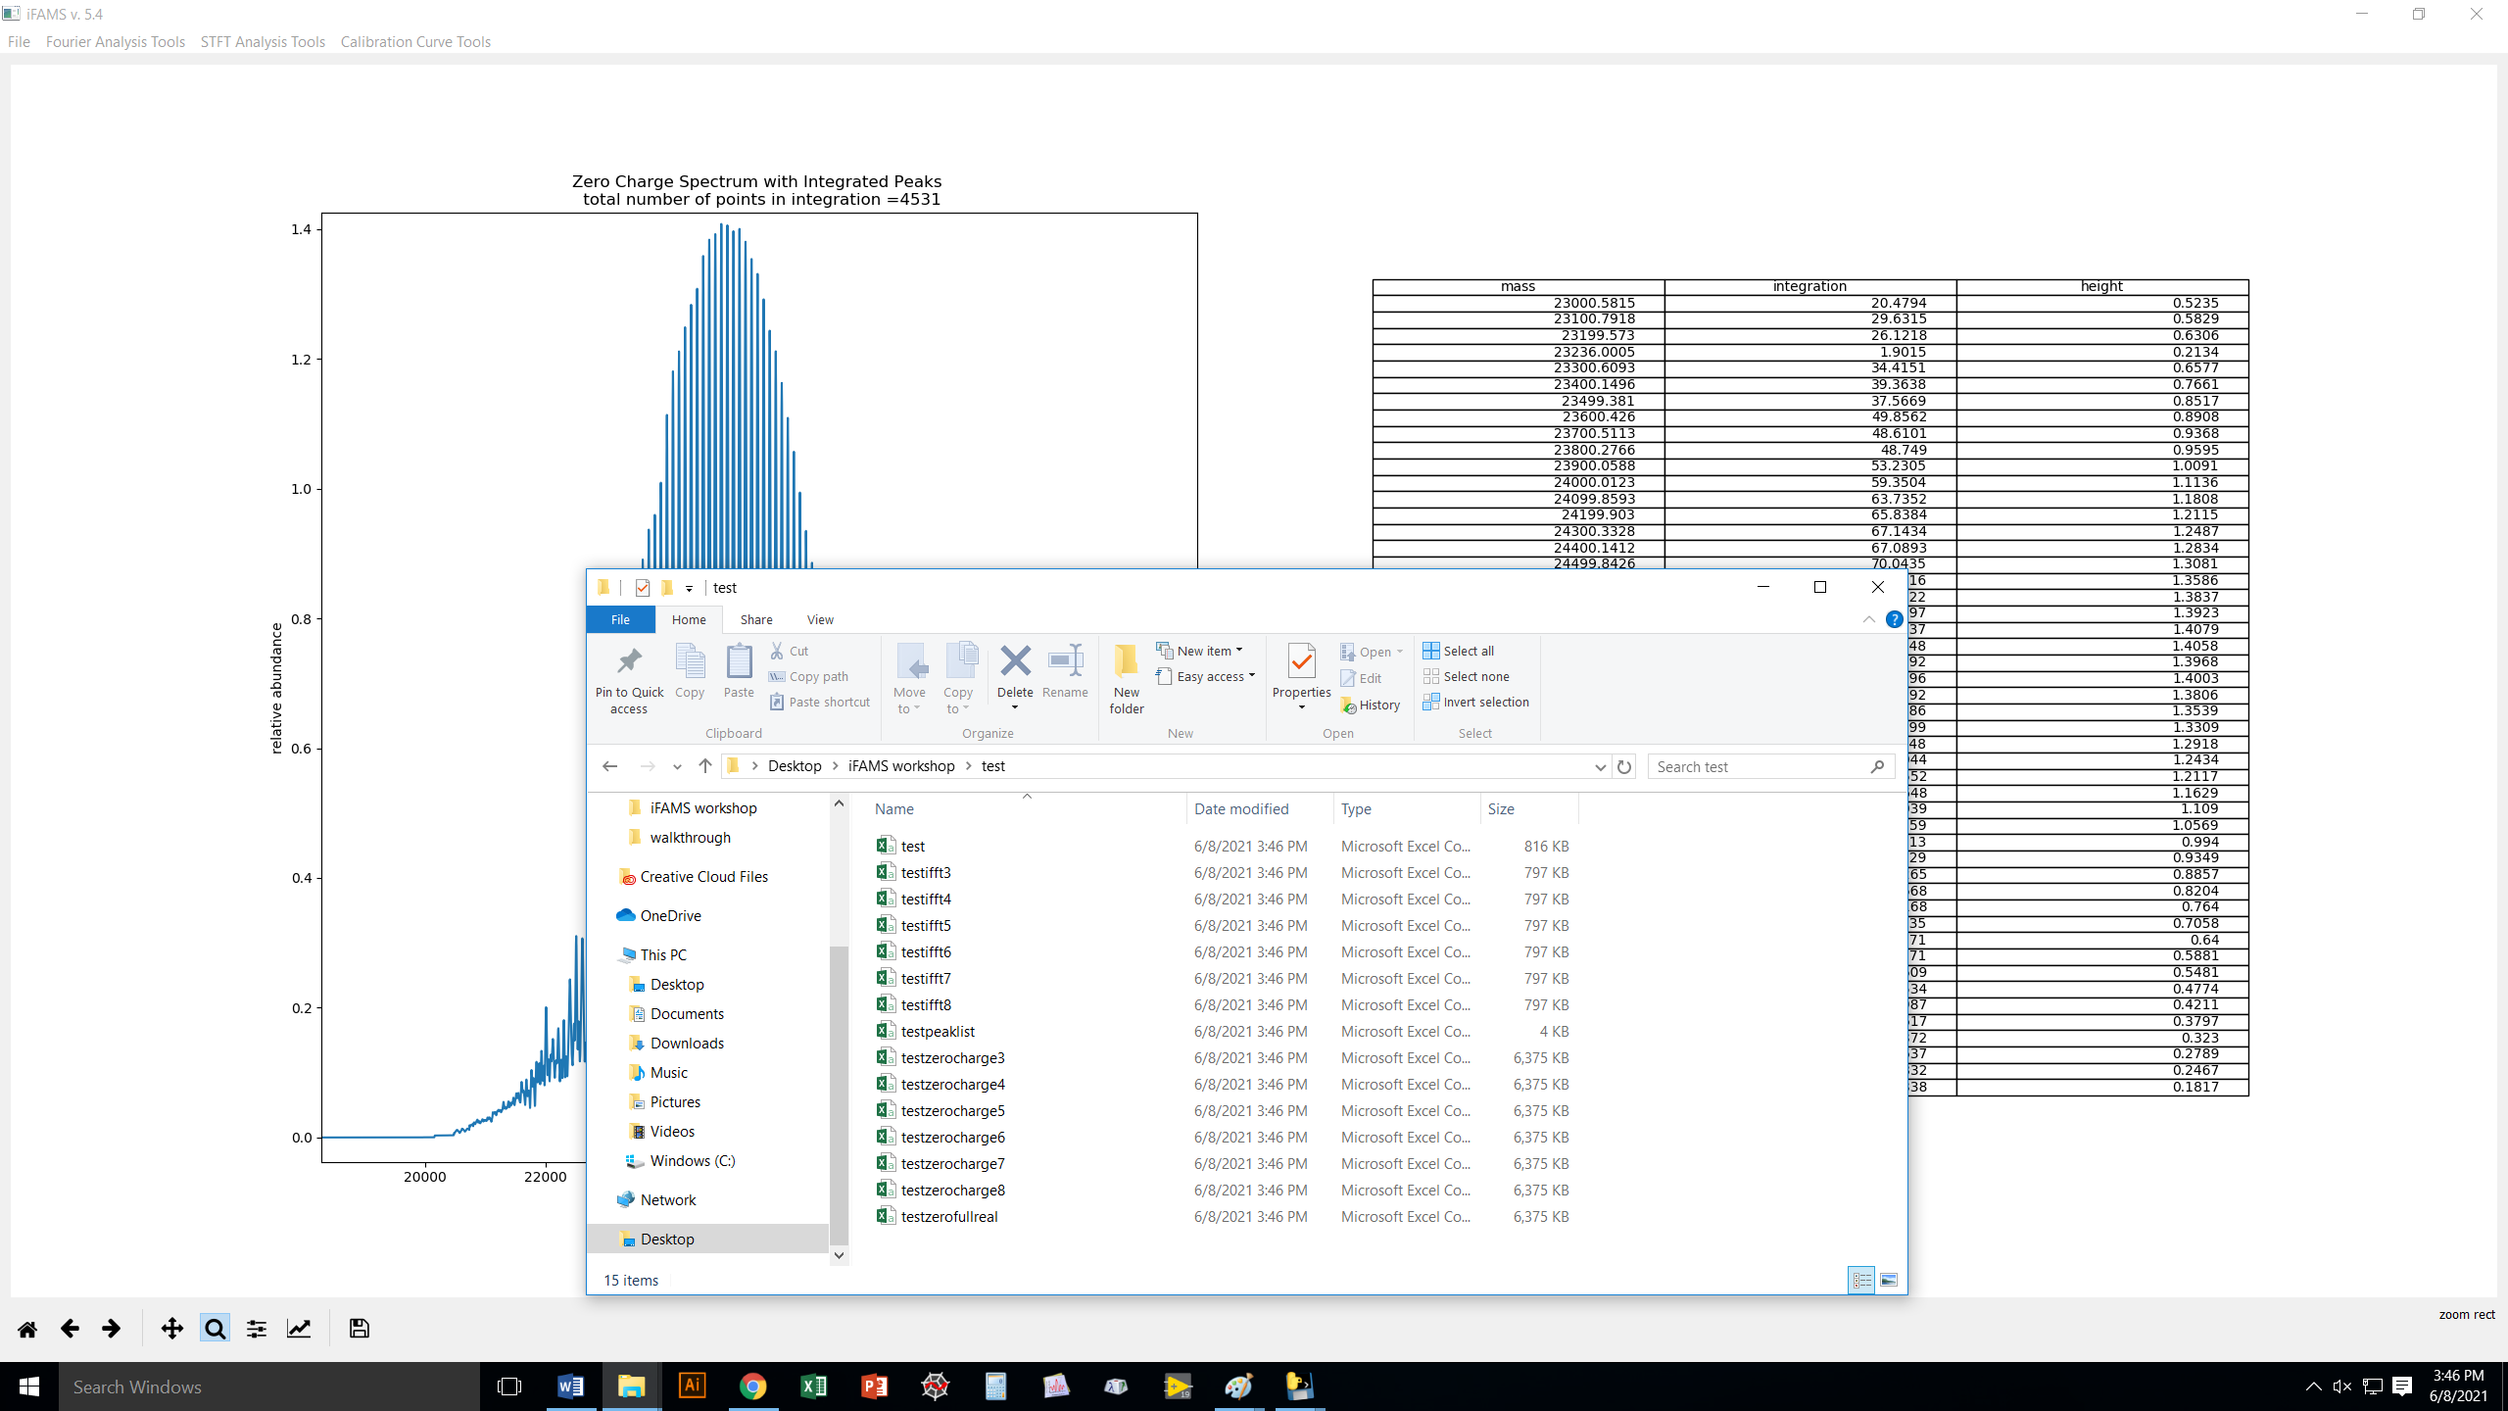
This file contains the integrated
peaks and their centroid masses.

Slide 61
Real Sample: α-Hemolysin from Staph. aureus
in intact FOS-14 detergent micelles
A couple notes:
We use just the raw mass spectrum with no pre-smoothing or pre-filtering
(not necessary, because GT is itself a “notch” filter by nature)
Going into this, we know:
1) monomer weighs 33,259 Da (from no-detergent measurements)
2) FOS-14 weighs 379.5 Da

Slide 62
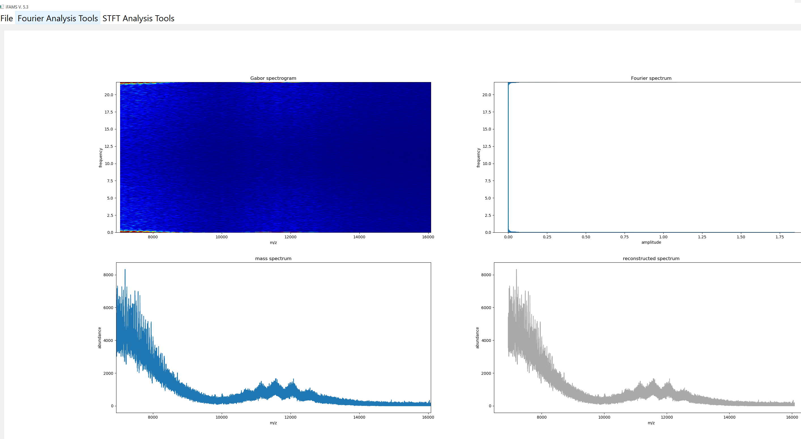
Where is the signal?
Zoom in on the FT spectrum →

Slide 63
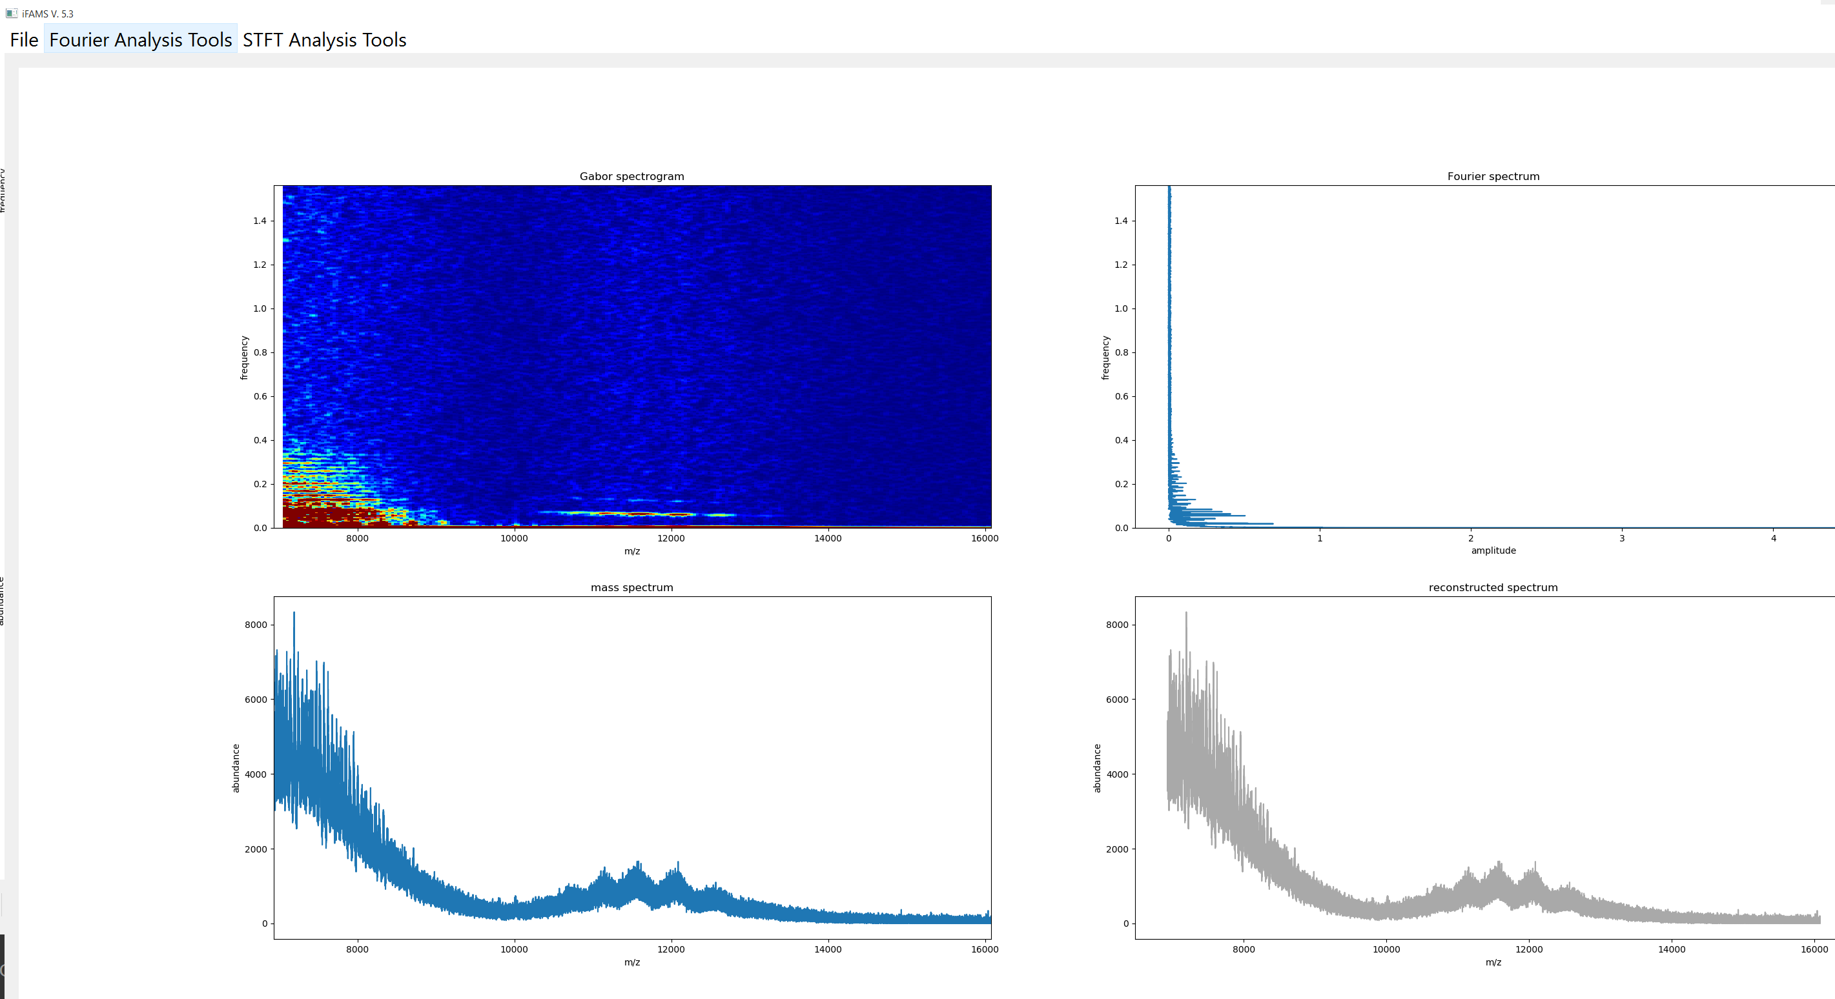

Slide 64


Slide 65

Note how complex FT spectrum is.
GT is easier to “read”!

Slide 66

Can already see two native ion types!

Slide 67

I just selected the boxes quickly; you could be more precise if you like.
Get charge states by hovering over middle of box,
read of frequency coordinate, multiply by
known FOS-14 mass. e.g., 0.05797*379.5 = 22+

Slide 68


Slide 69

Hover cursor over peak to get
mass (or look at output file).
Based on known αHL and FOS-14
monomer masses,
240,745 Da = (αHL)₆ + 109 FOS-14
277,360 Da = (αHL)₇ + 117 FOS-14
heptamer
hexamer
…and of course we could include harmonics to get lipid resolution

Slide 70
Stay tuned for more demos.
Coming soon:
Deconvolution of intact, denatured antibodies, glycosylated
proteins, and PEGylated proteins (no fundamental or
harmonics needed!)
Automated quantitation, including batch processing and
calculation of calibration curves
Phase-based reconstruction of Macromolecular Mass Defect
profiles

Slide 71
Thanks for your attention, and happy deconvolution!
github.com/prellgroup/iFAMS/releases
Development of iFAMS is supported by:
The National Science Foundation (grant CHE-1752994)
An American Society for Mass Spectrometry Research Award
A generous donation from Agilent Technologies, Inc.

